Slide 1
Comparative Analysis of Load Balancing Algorithms in General Graphs
Presentation by: Emre Bayazitoglu
Supervised by: Saptadi Nugroho

Slide 2
Overview
Motivation
Recap
Setting
Results
Complete Graph
Grid Graph
Lollipop Graph
Closed Chain Graph
Star Graph
Ring of Cliques
Sources
Ressources

Slide 3
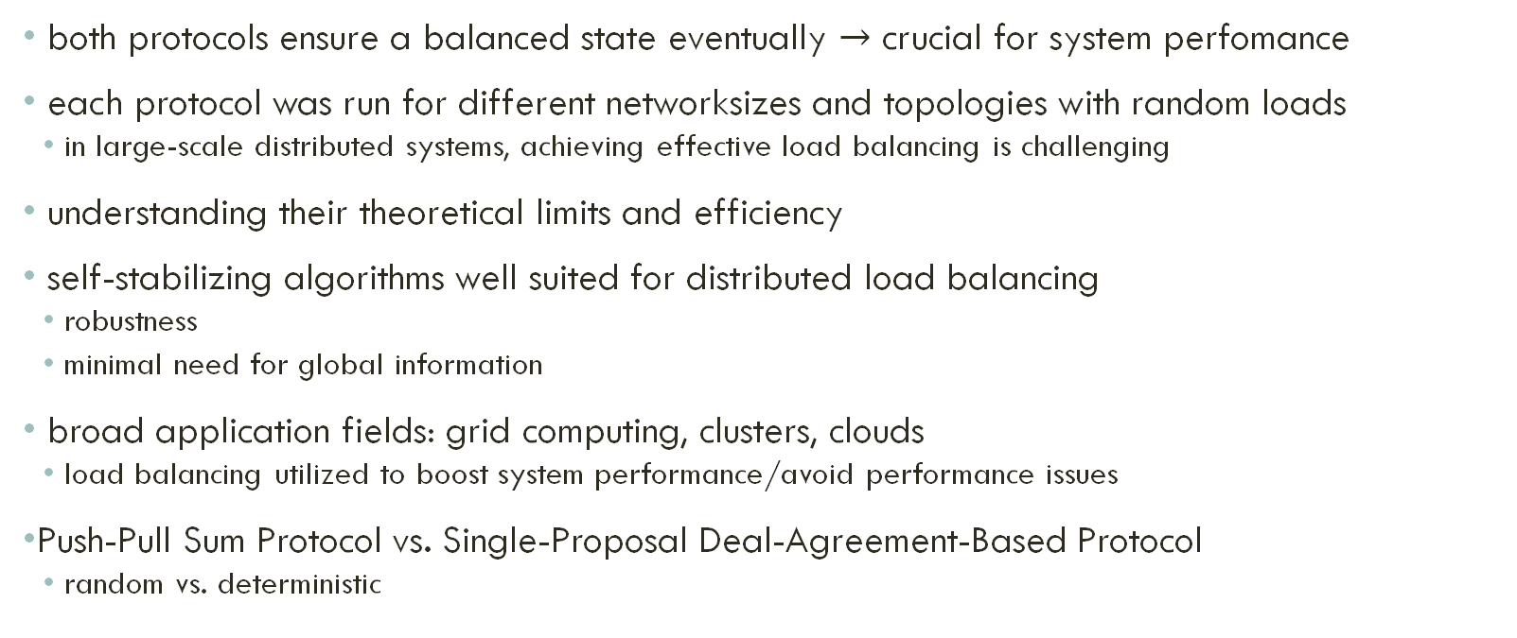
Motivation
both protocols ensure a balanced state eventually $→$ crucial for system perfomance
each protocol was run for different networksizes and topologies with random loads
in large-scale distributed systems, achieving effective load balancing is challenging
understanding their theoretical limits and efficiency
self-stabilizing algorithms well suited for distributed load balancing
robustness
minimal need for global information
broad application fields: grid computing, clusters, clouds
load balancing utilized to boost system performance/avoid performance issues
Push-Pull Sum Protocol vs. Single-Proposal Deal-Agreement-Based Protocol
random vs. deterministic

Slide 4
Setting
Peer-to-Peer networks
continous
synchronous
each simulation was run for 50 rounds
x-axis number of rounds
y-axis Mean Squared Error (MSE)

Slide 5
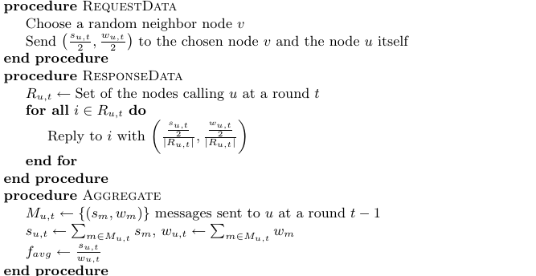
Push-Pull Sum Protocol (PPS)
continous
randomized
approach: distribute loads using the element of randomness
every node calls:
Aggregate procedure
RequestData procedure
ResponseData procedure
[1] Push-Pull Sum Protocol

Slide 6
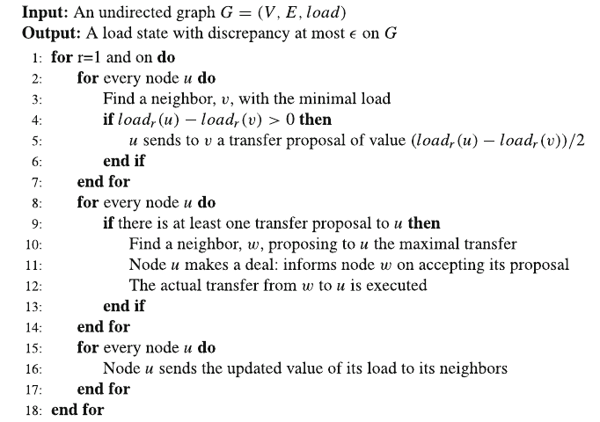
Single-Proposal Deal-Agreement-Based Protocol (DAB)
continous
deterministic
approach: negotiate if and how much load is transfered
three phases:
Proposal
Deal
Summary
[2] Single-Proposal Deal-Agreement-Based Protocol

Slide 7
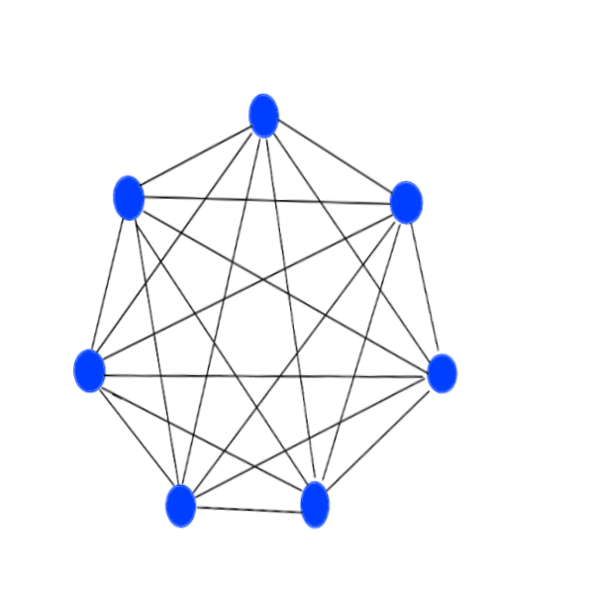

Complete Graph
$n$ vertices
$\frac{n∗(n−1)}{2}$ edges
winner: Push-Pull Sum Protocol

Slide 8
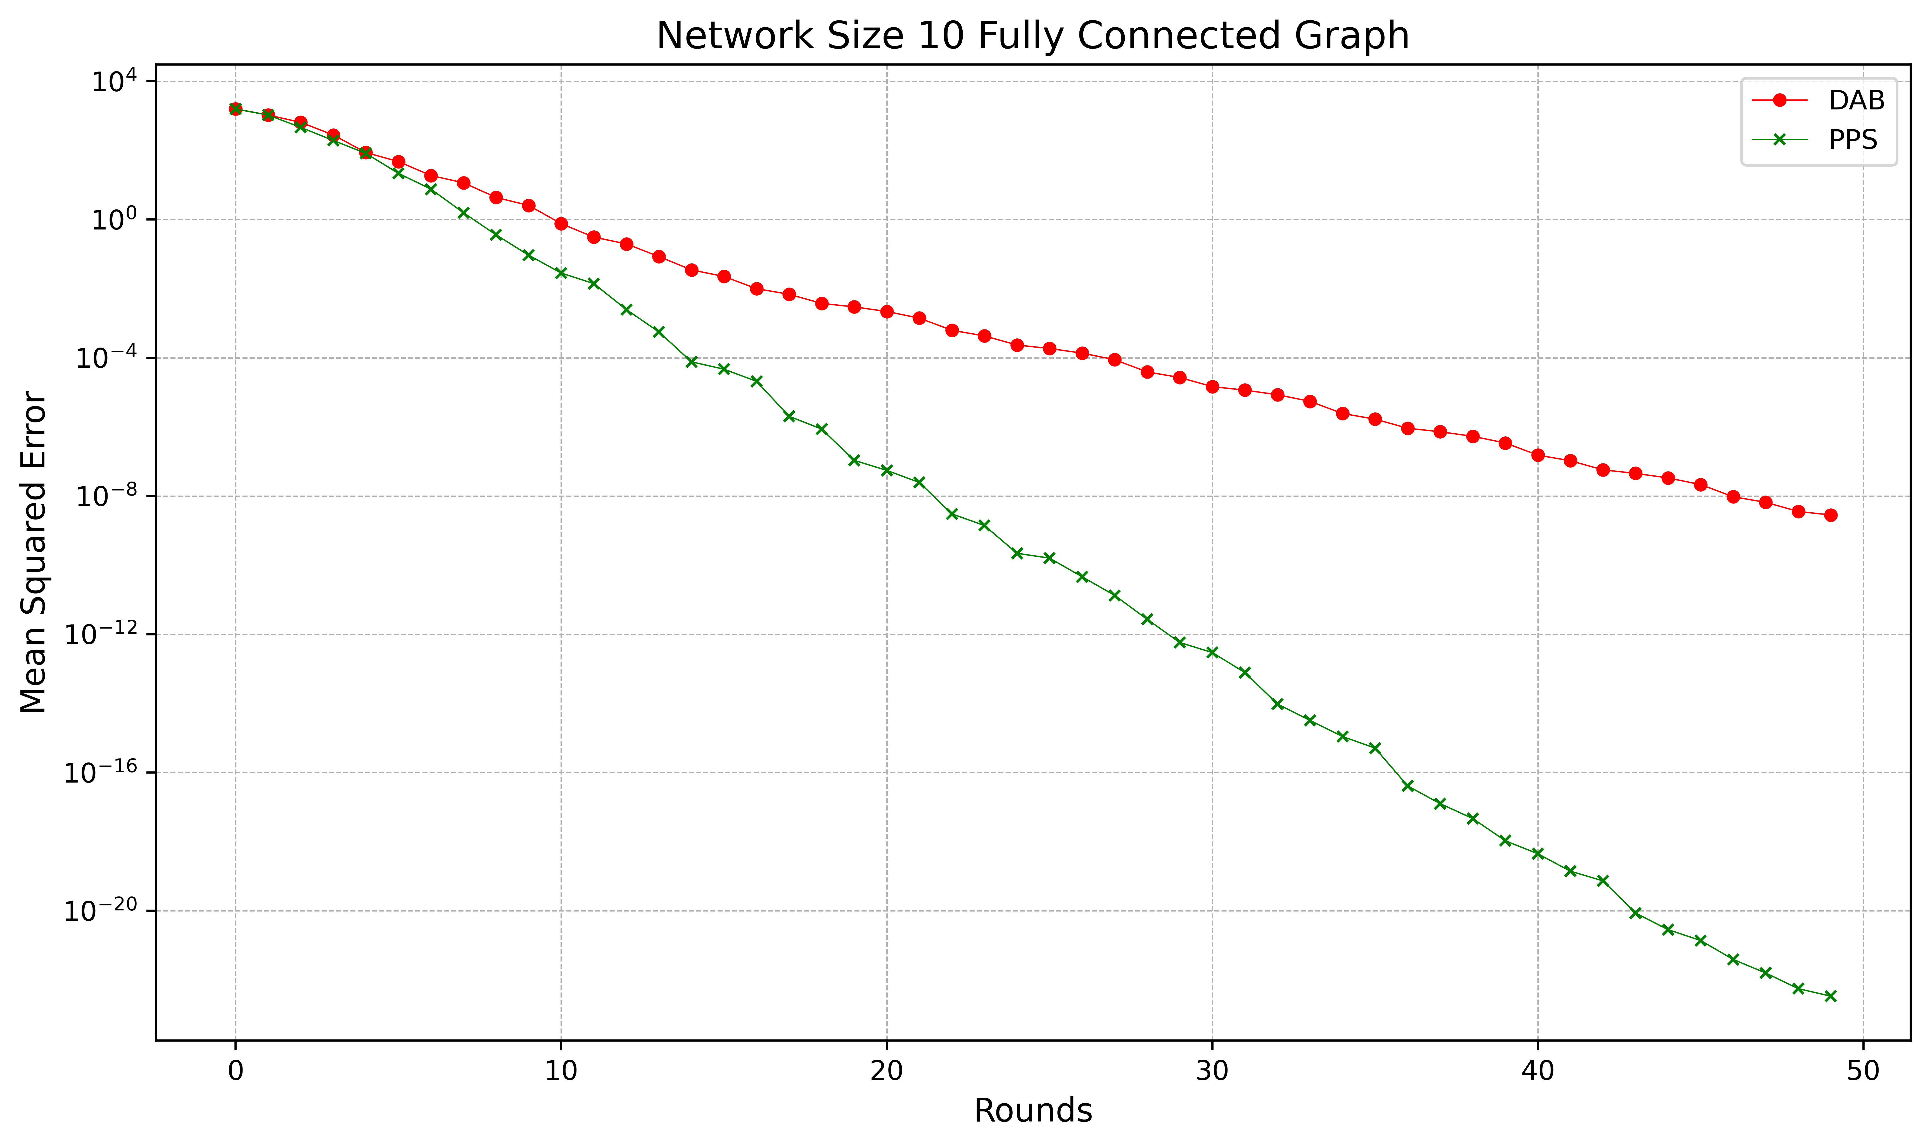
Complete Graph: Networksize 10

Slide 9
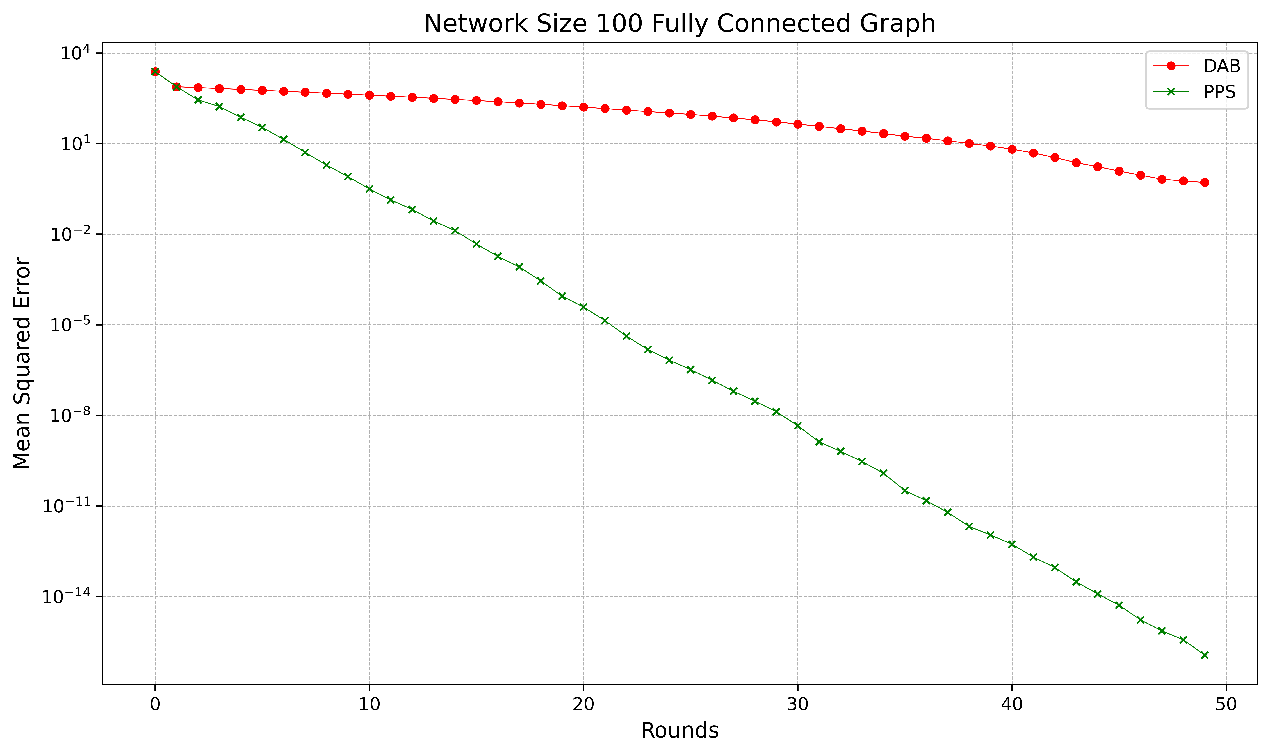
Complete Graph: Networksize 100

Slide 10
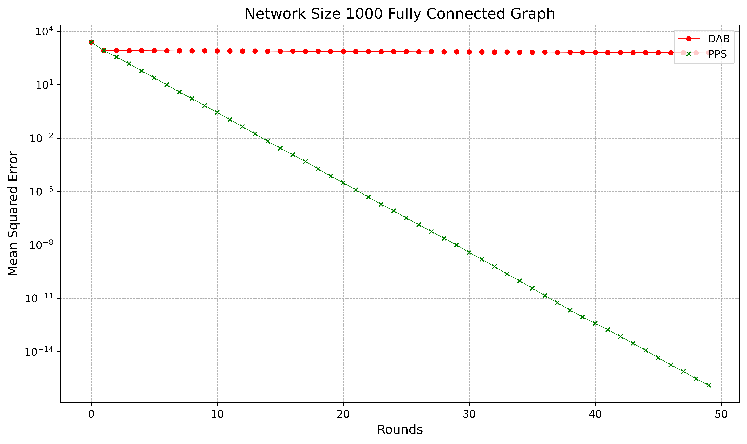
Complete Graph: Networksize 1.000

Slide 11
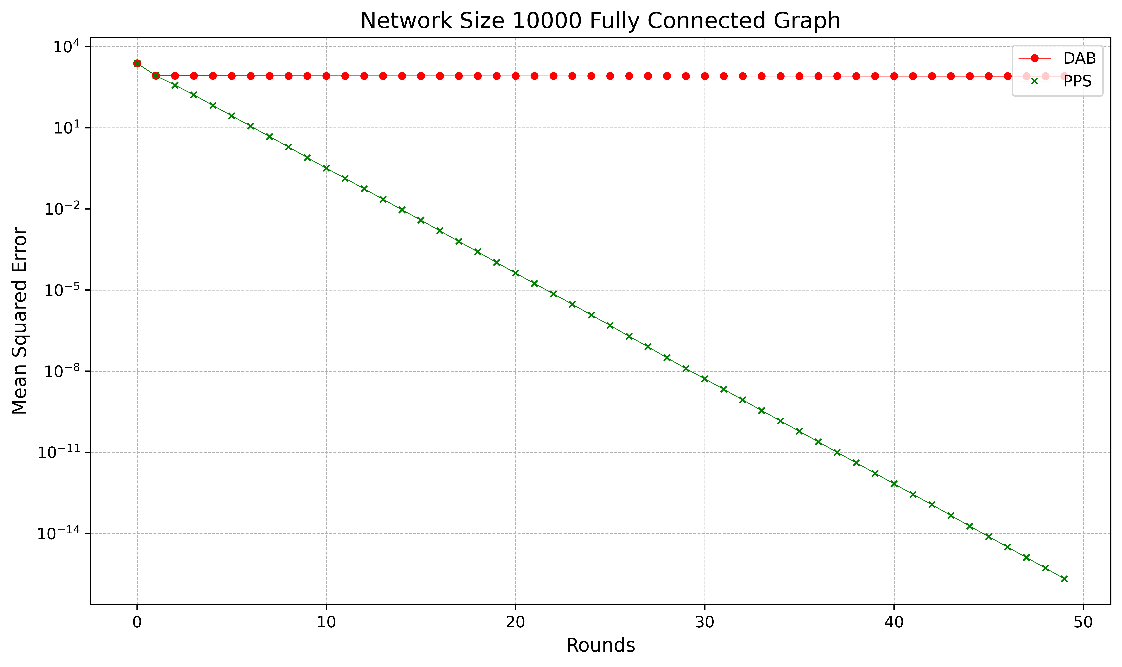
Complete Graph: Networksize 10.000

Slide 12
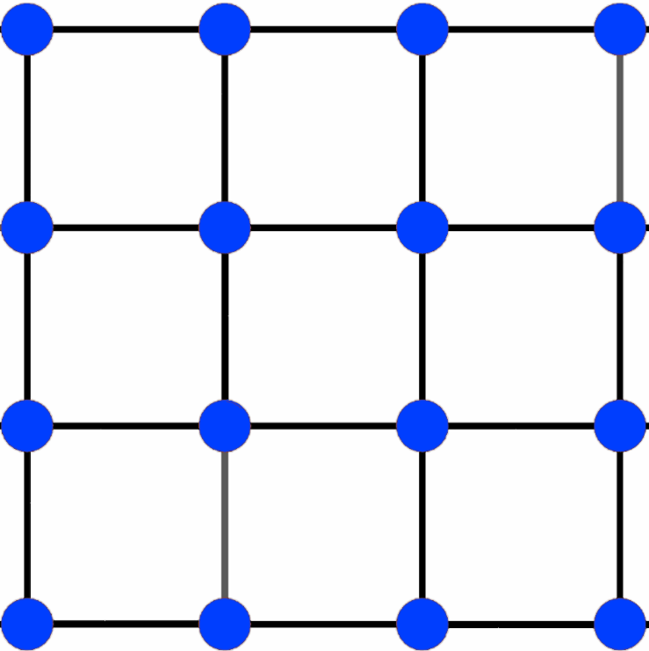
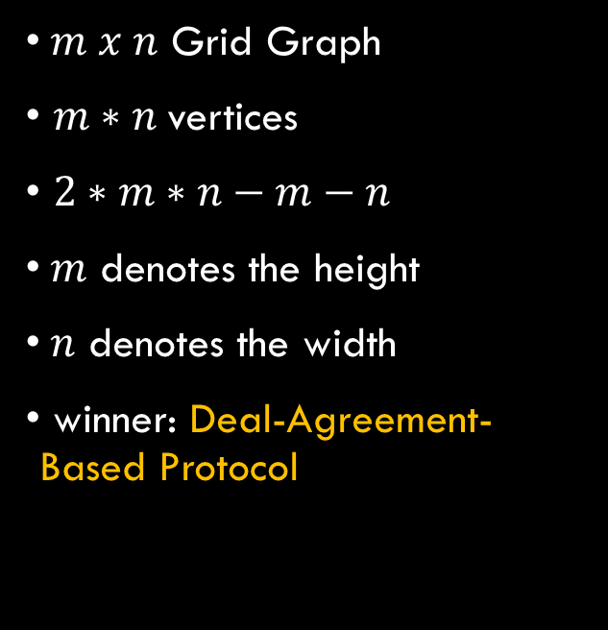
Grid Graph
$m x n$ Grid Graph
$m∗n$vertices
$2∗m∗n−m−n$
$m$ denotes the height
$n$ denotes the width
winner: Deal-Agreement-Based Protocol

Slide 13
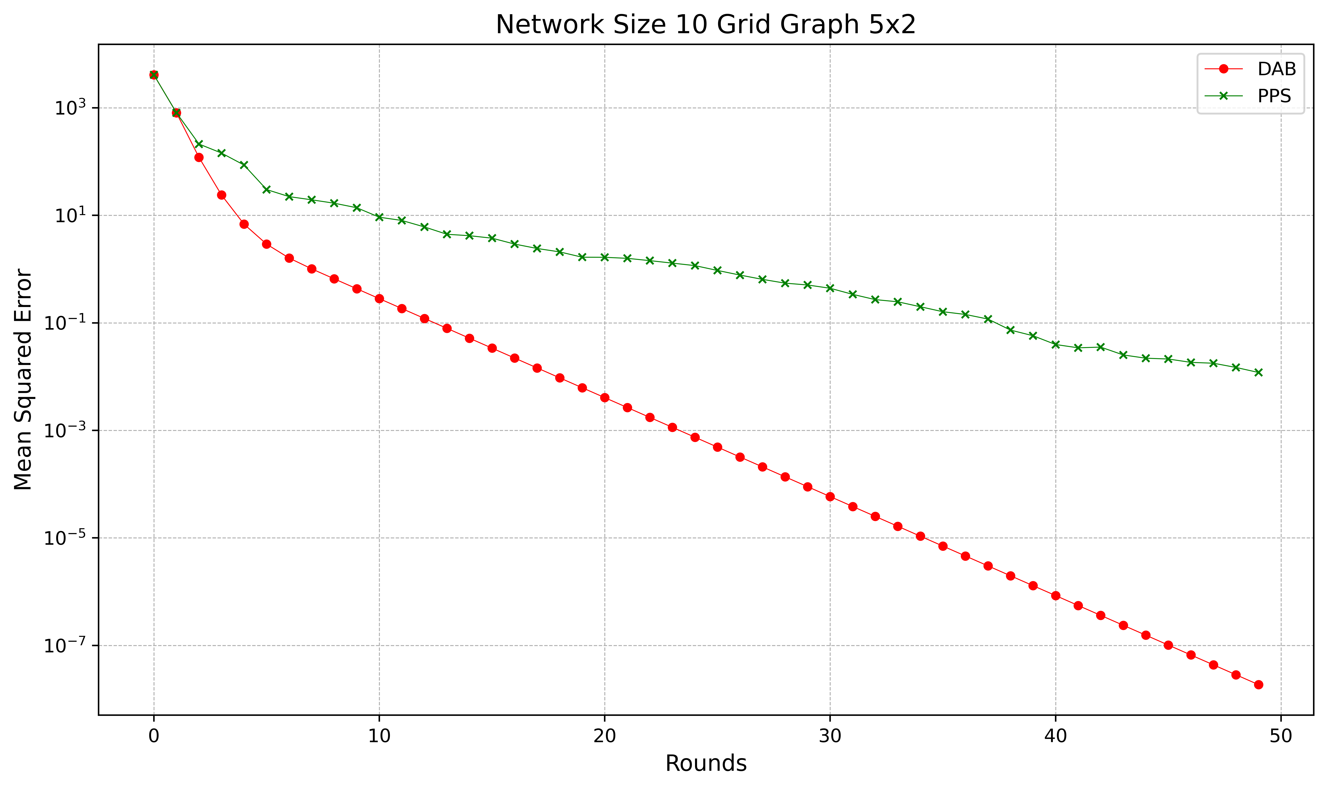
5x2 Grid Graph: Networksize: 10

Slide 14
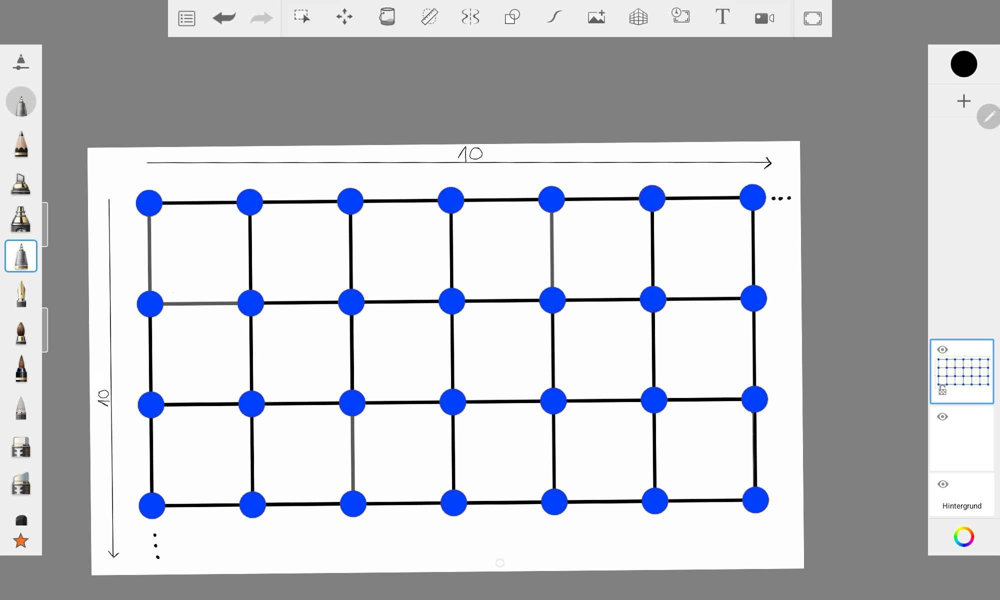
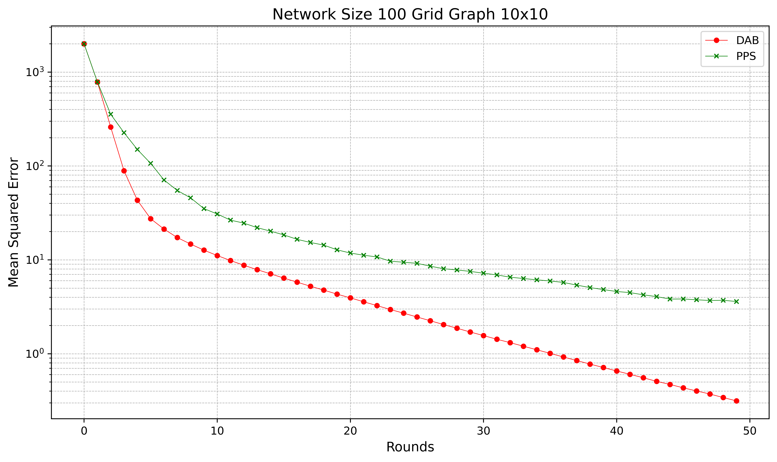
10x10 Grid Graph: Networksize 100

Slide 15

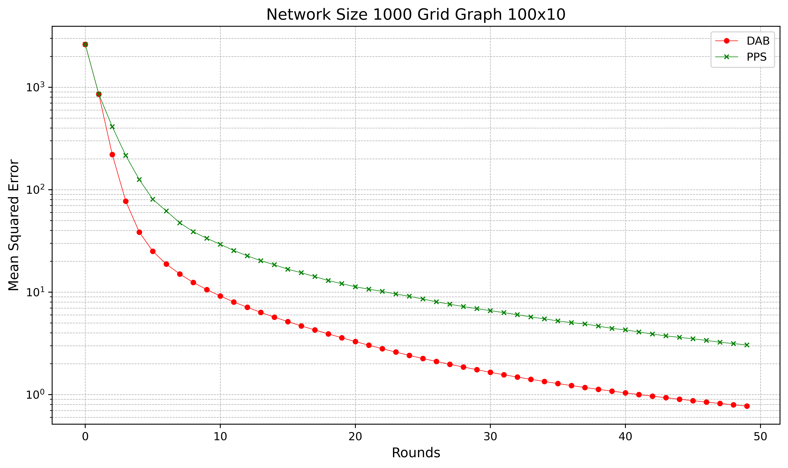
100x10 Grid Graph: Networksize 1.000

Slide 16
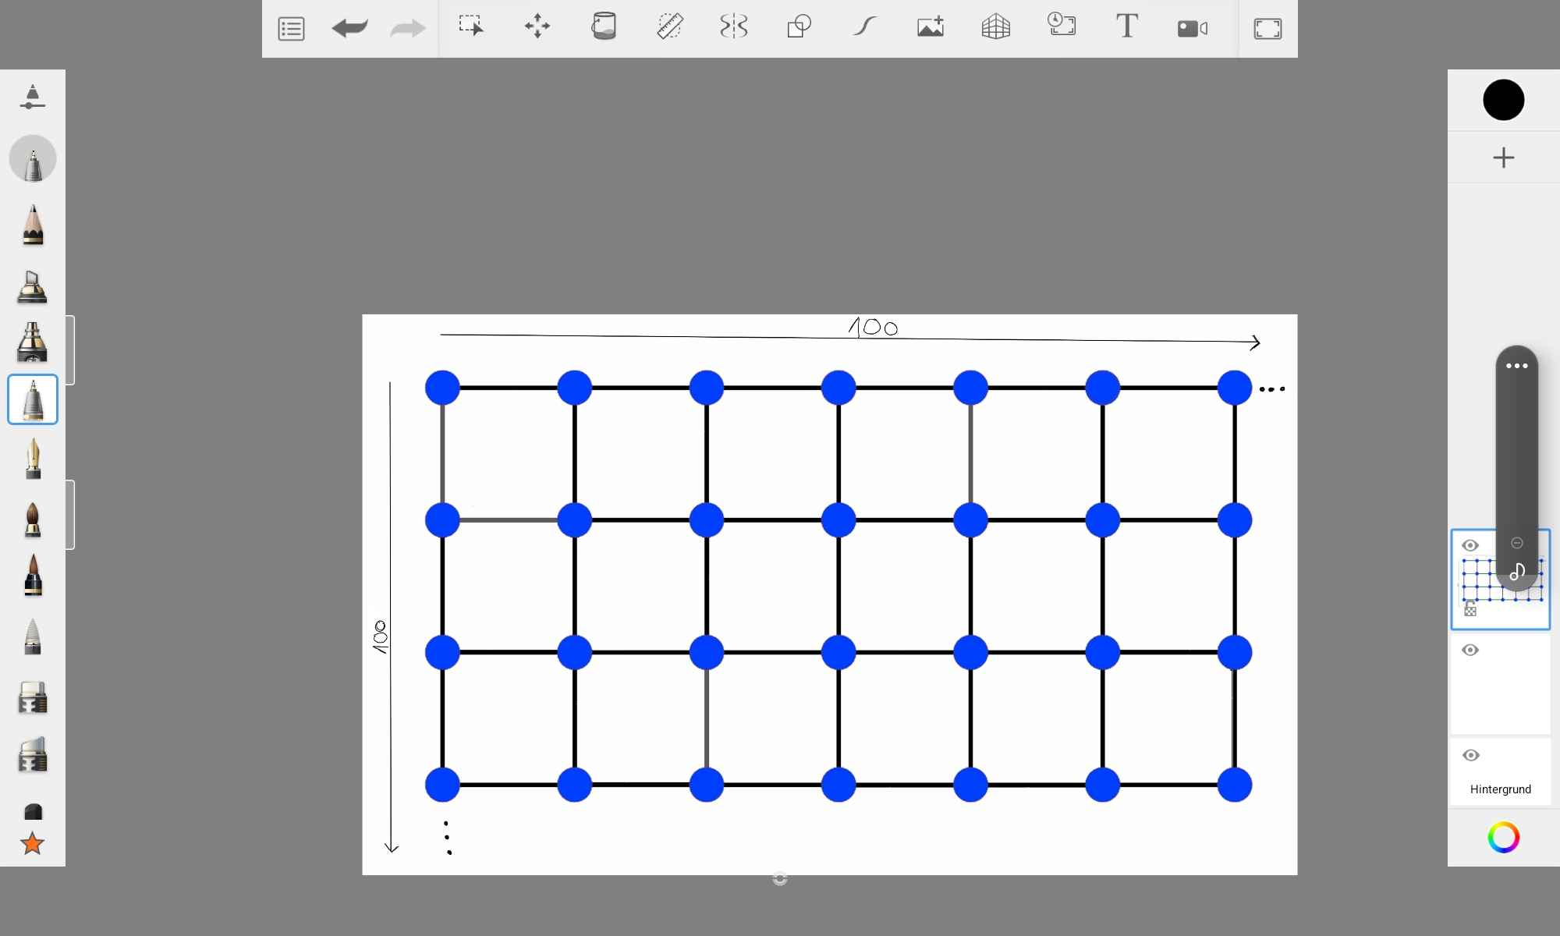
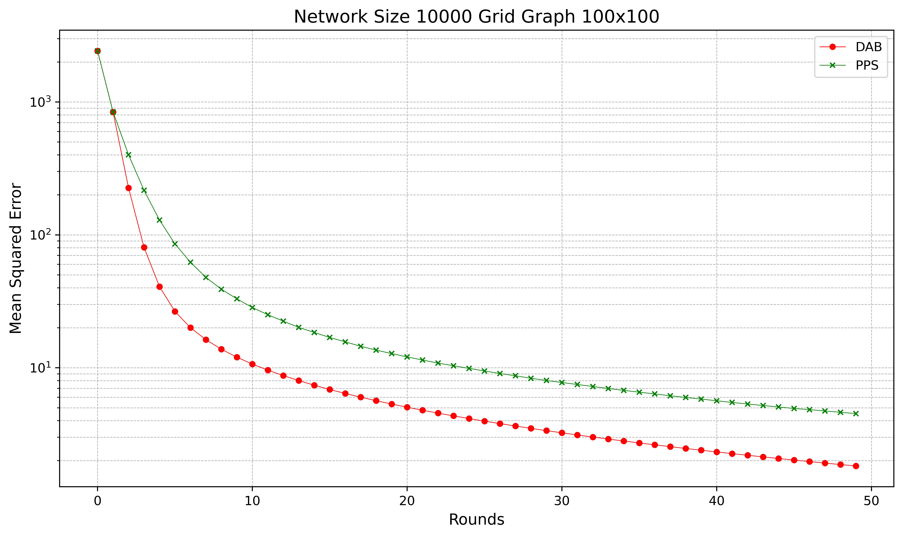
100x100 Grid Graph: Networksize 10.000

Slide 17
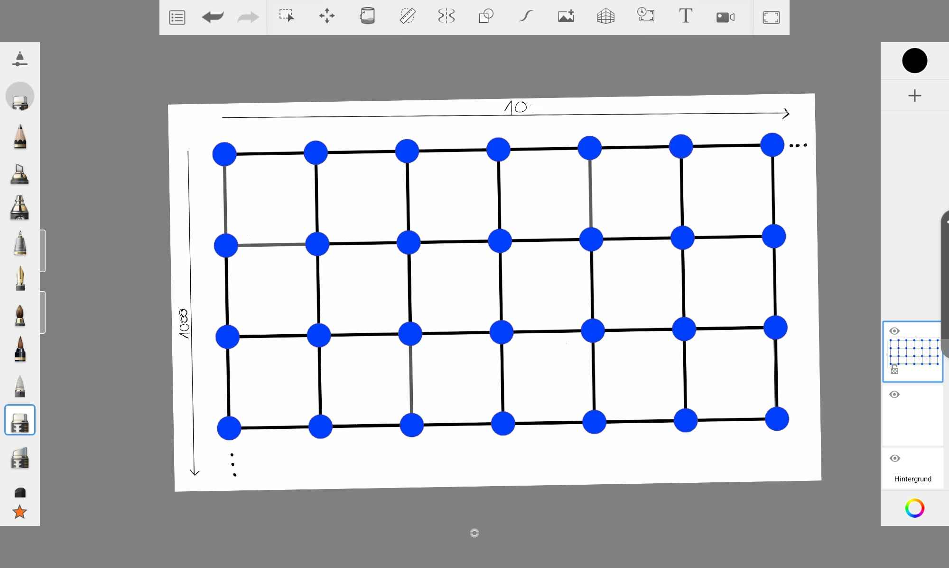
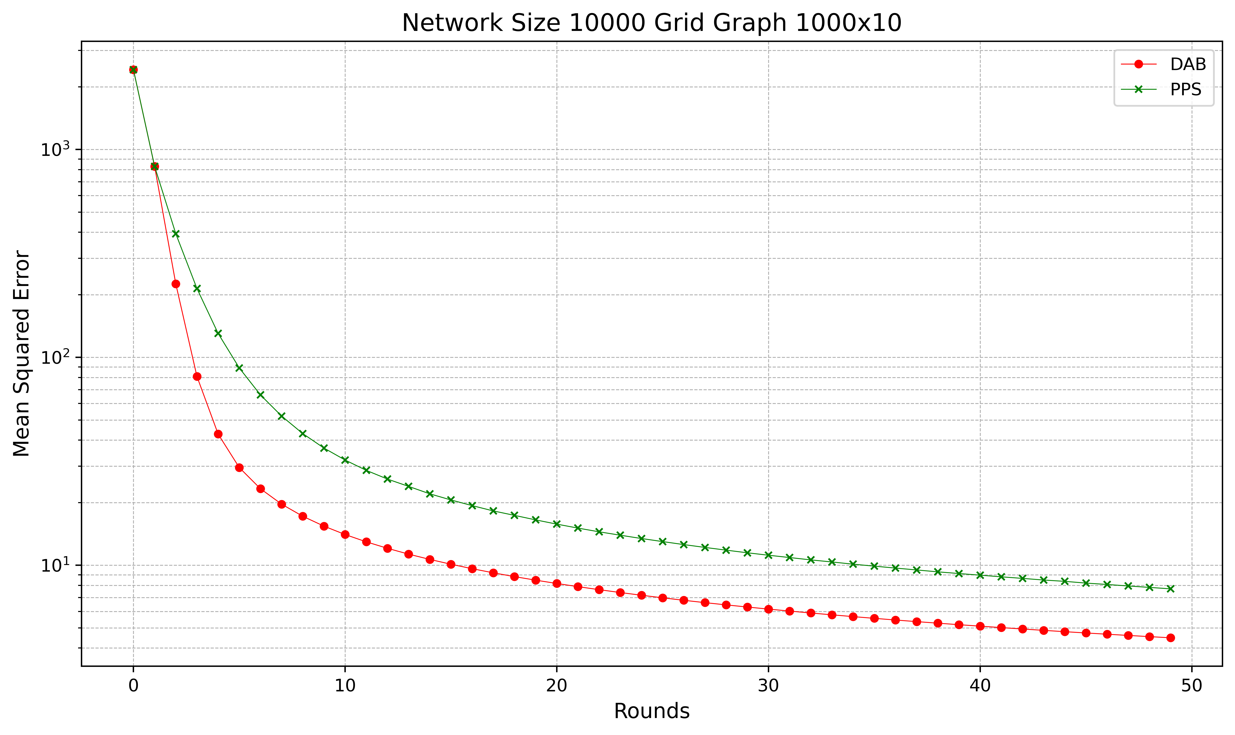
1000x10 Grid Graph: Networksize 10.000

Slide 18

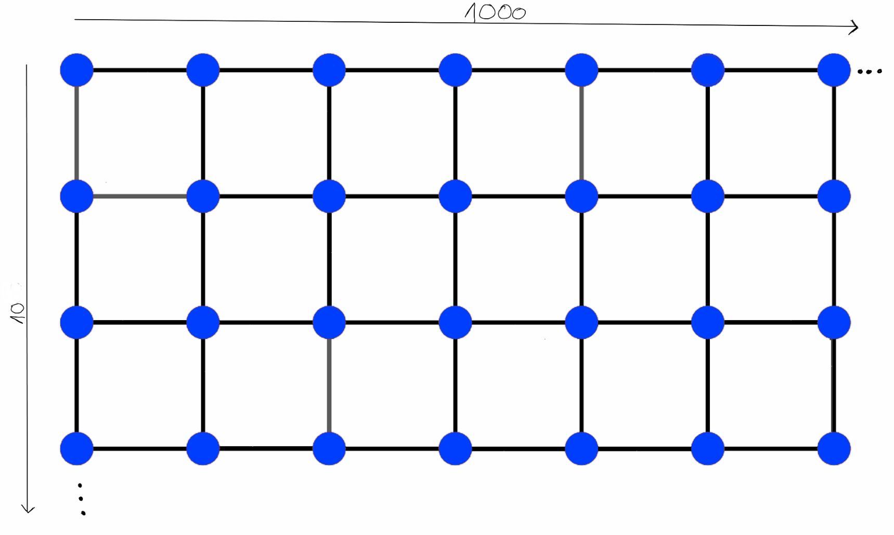
10x1000 Grid Graph: Networksize 10.000

Slide 19
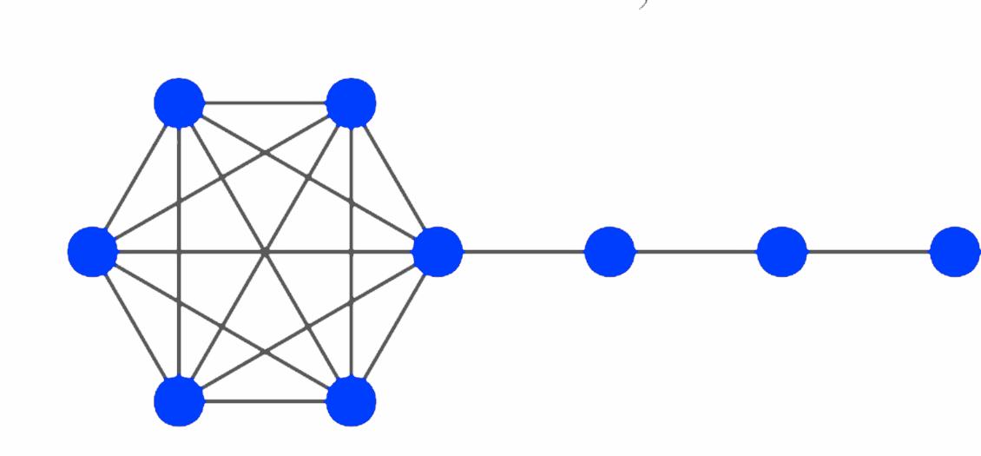
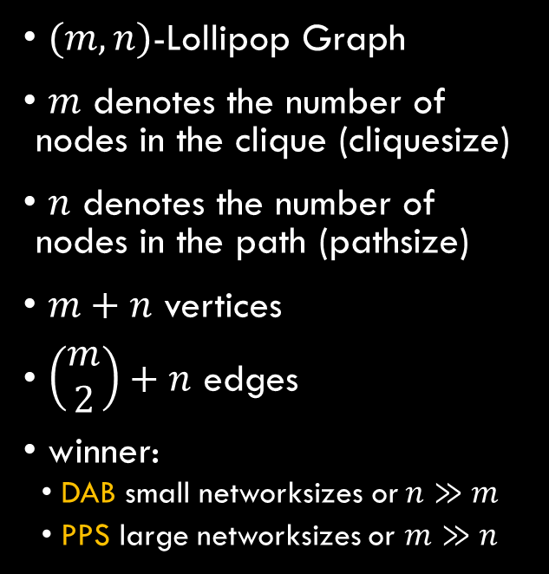
Lollipop Graph
$(m,n)$-Lollipop Graph
$m$ denotes the number of nodes in the clique (cliquesize)
$n$ denotes the number of nodes in the path (pathsize)
$m+n$ vertices
$\left(\begin{matrix}m \\ 2\end{matrix}\right)+n$ edges
winner:
DAB small networksizes or $n≫m$
PPS large networksizes or $m≫n$

Slide 20
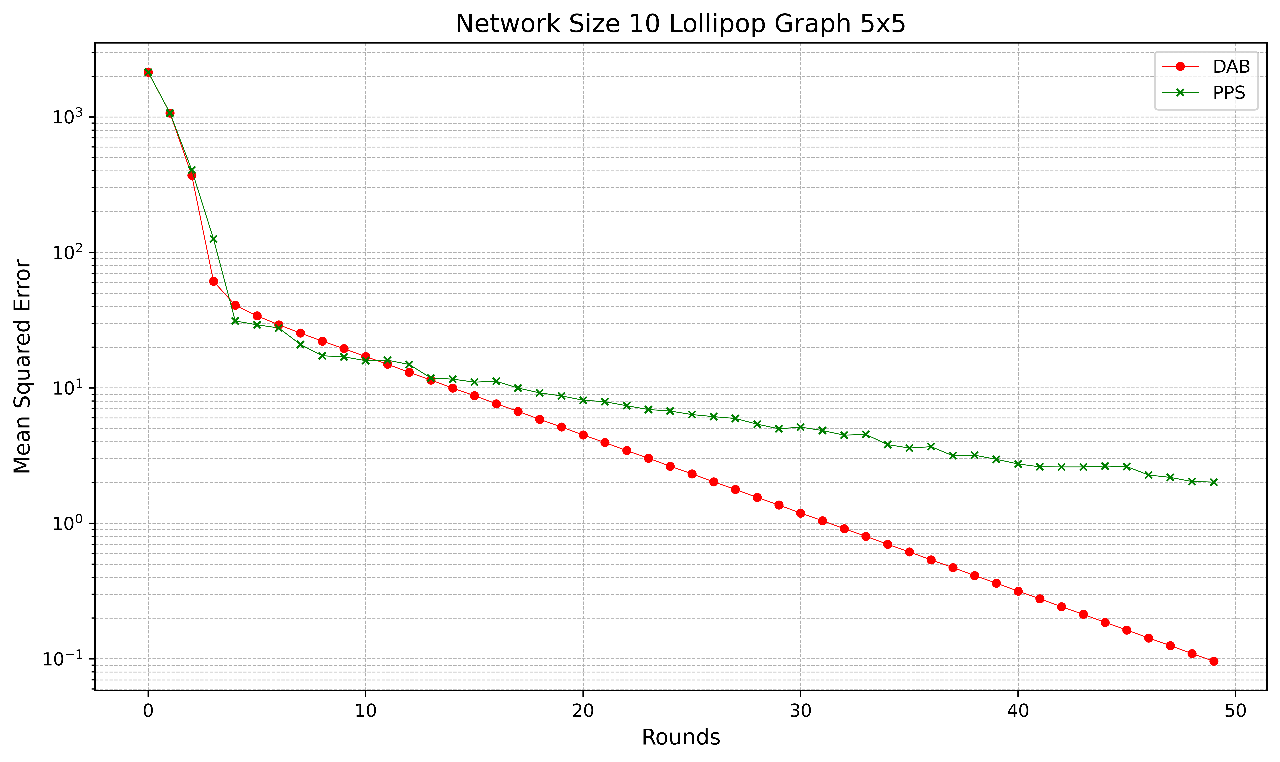
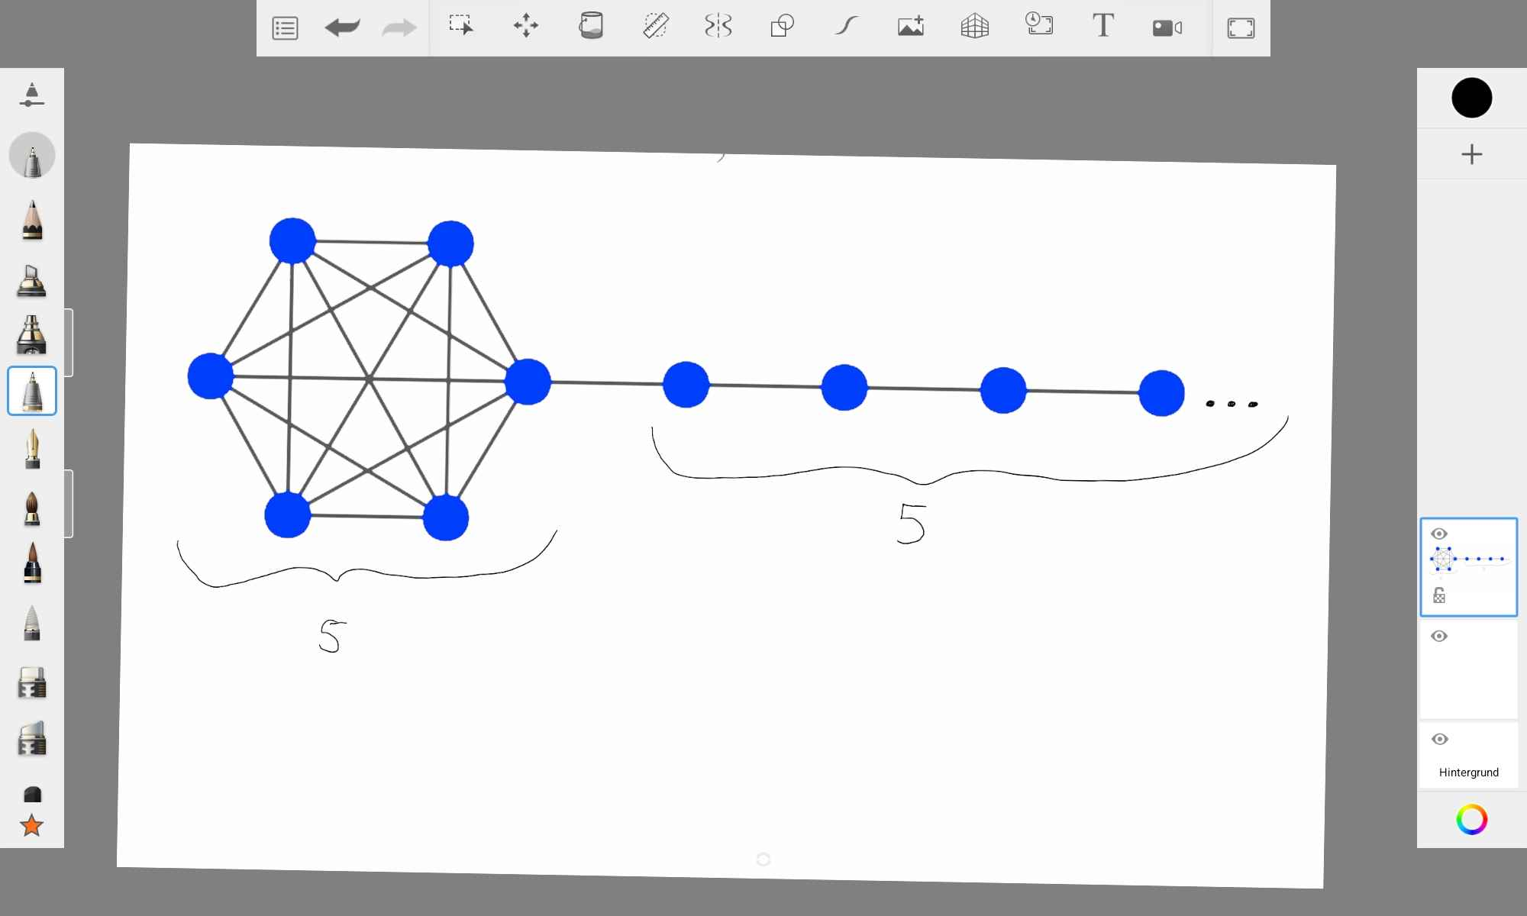
(5, 5)-Lollipop Graph: Networksize 10

Slide 21
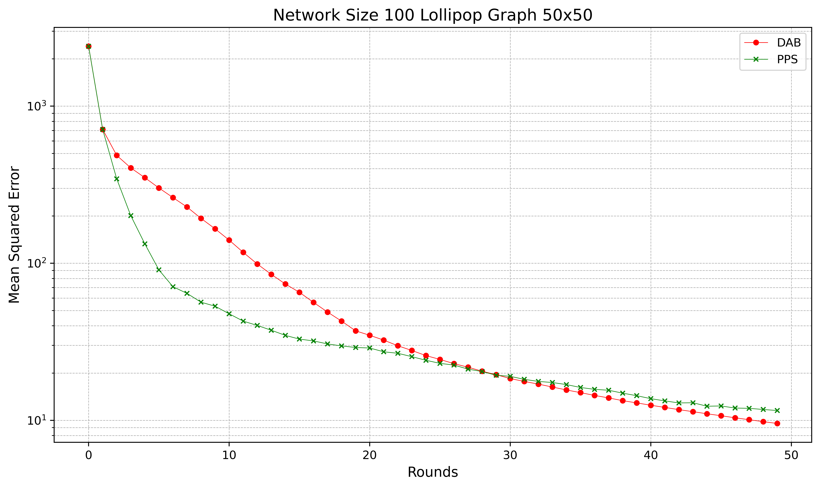

(50, 50)-Lollipop Graph: Networksize 100

Slide 22
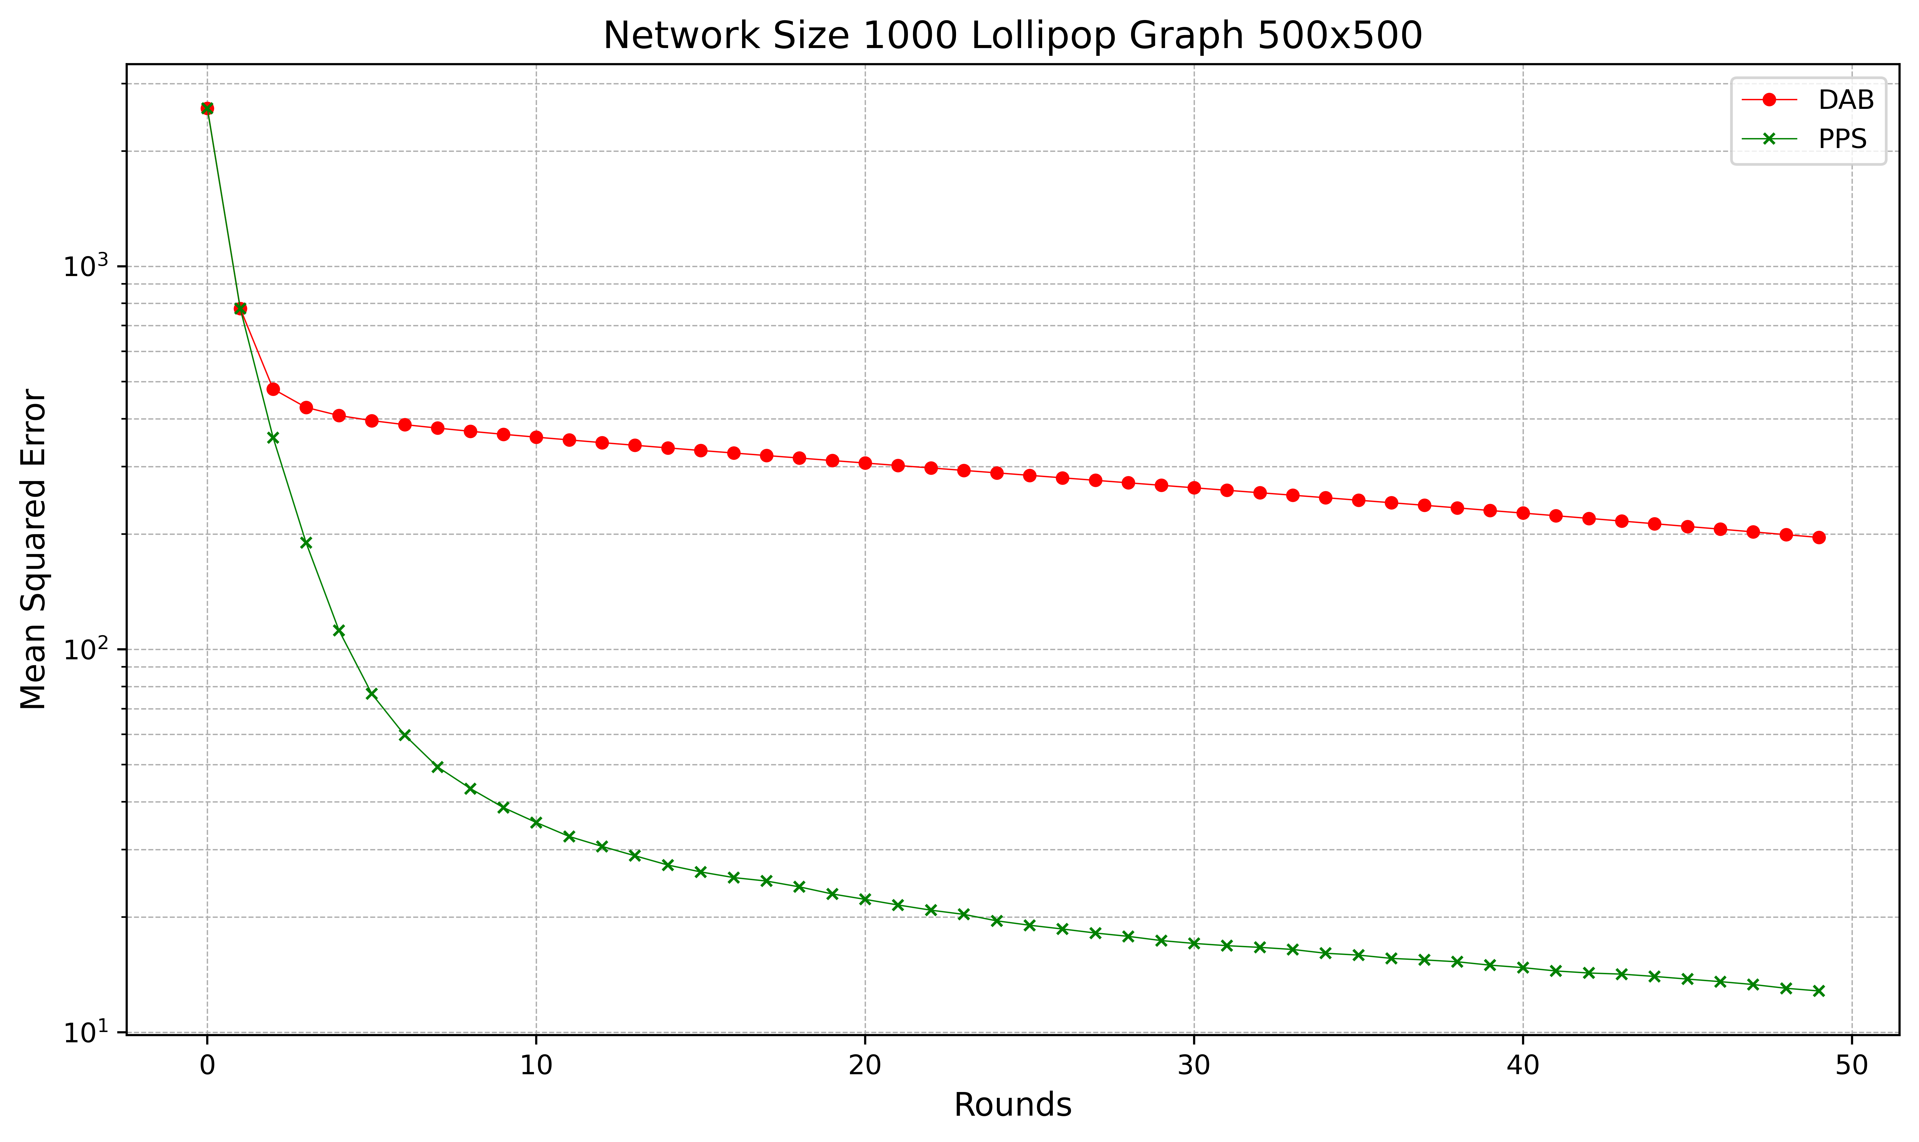

(500, 500)-Lollipop Graph: Networksize 1.000

Slide 23
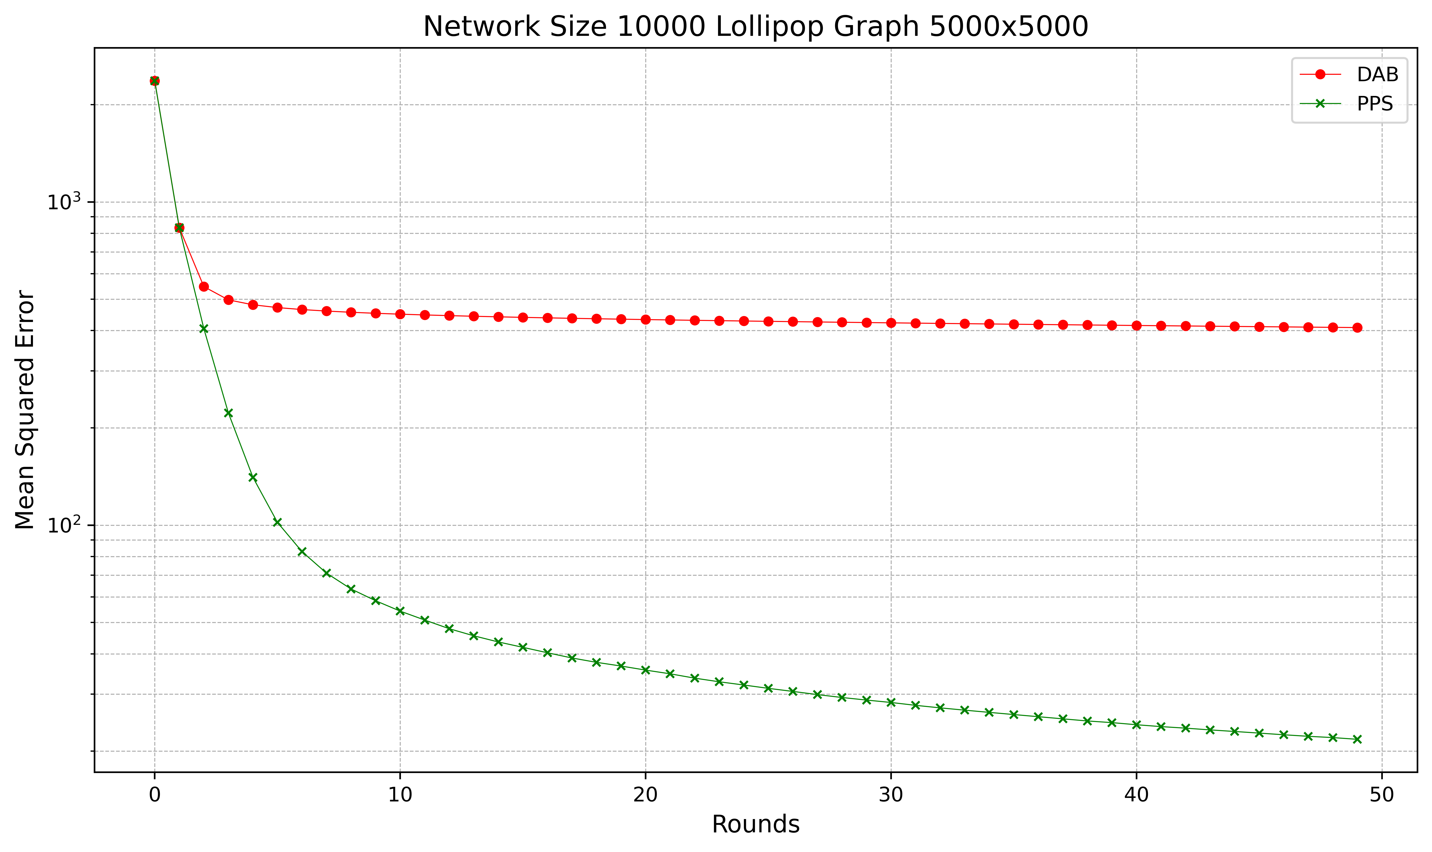

(5000, 5000)-Lollipop Graph: Networksize 10.000

Slide 24
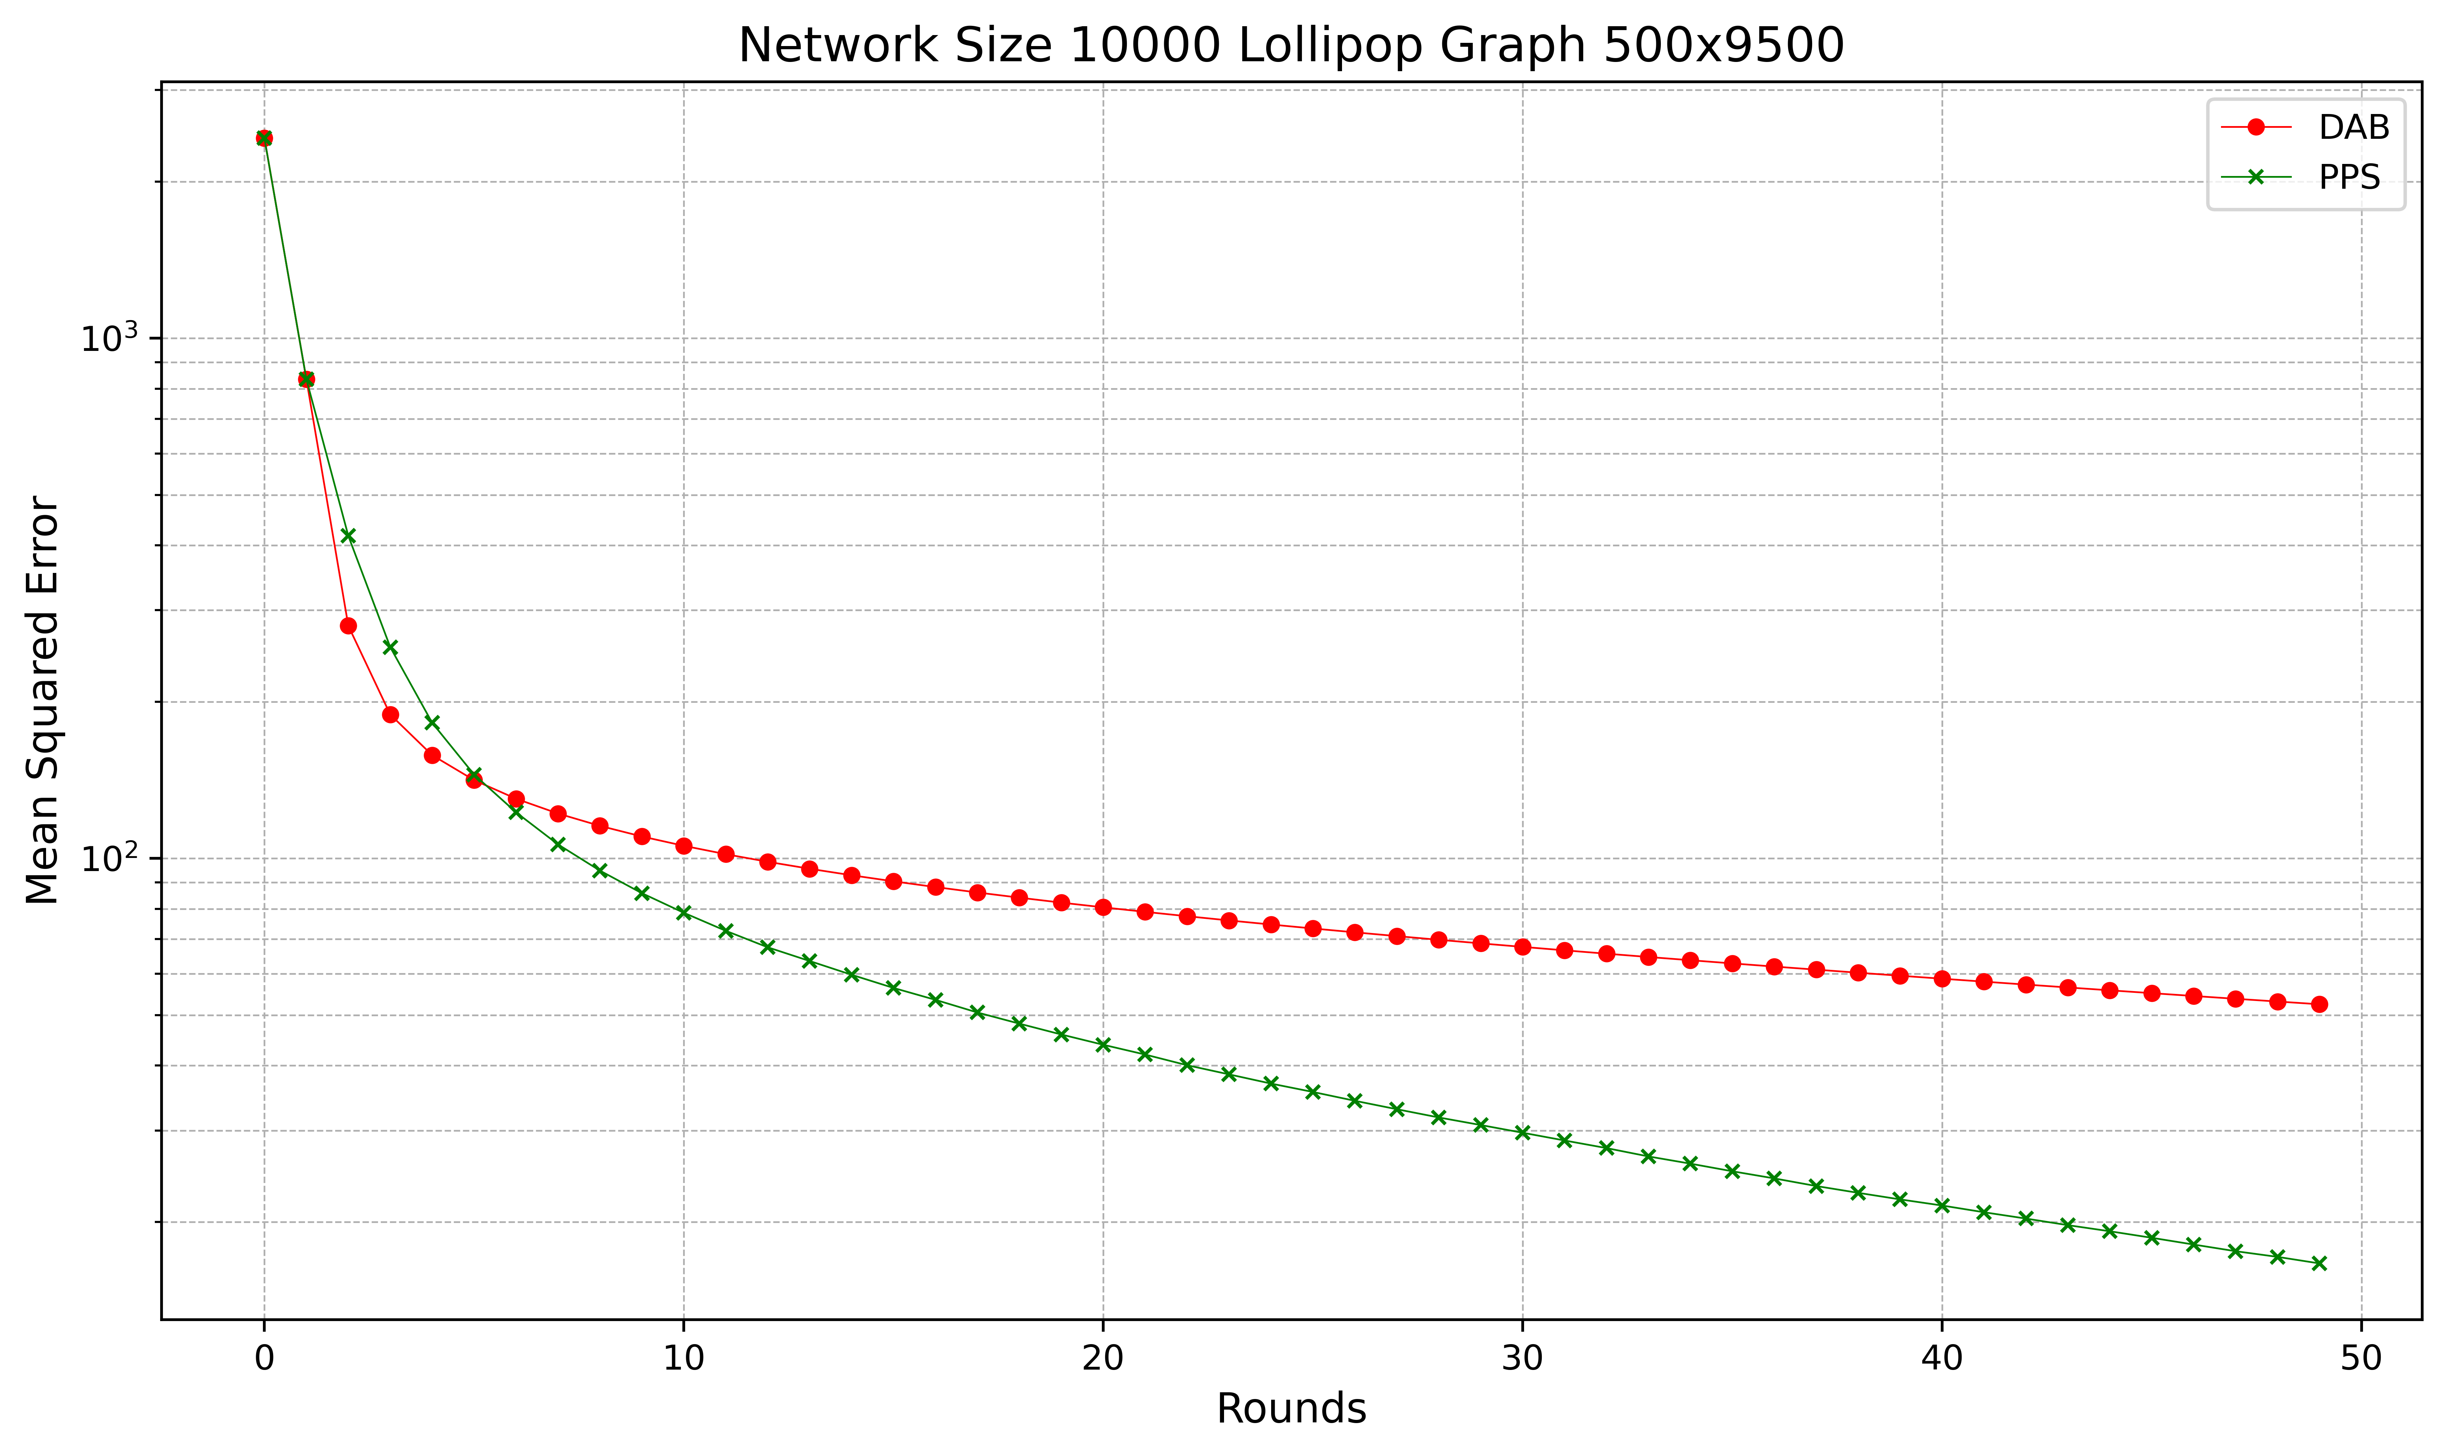
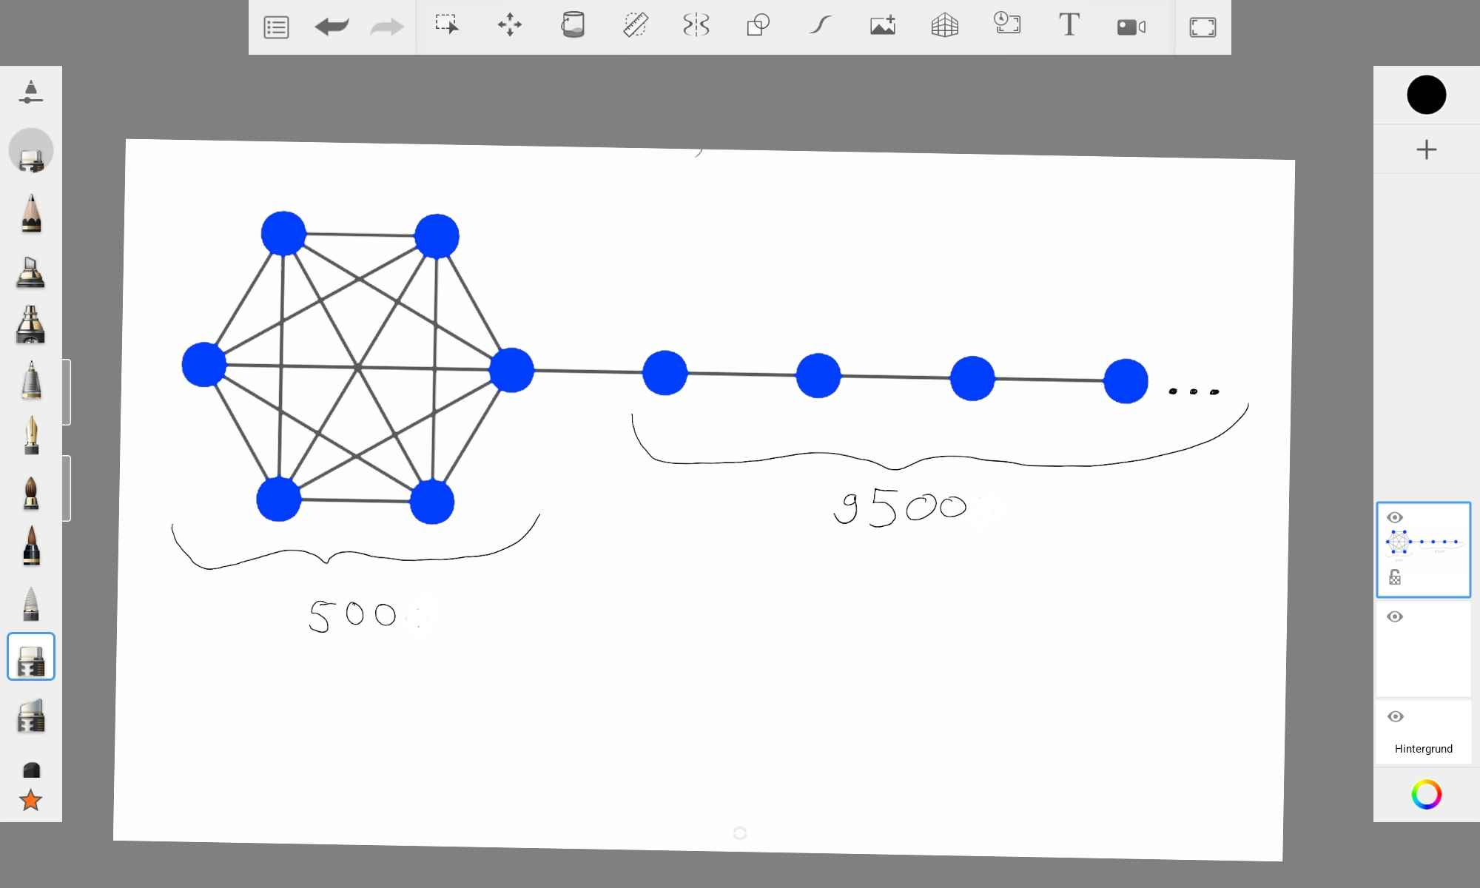
(500, 9500)-Lollipop Graph: Networksize 10.000

Slide 25
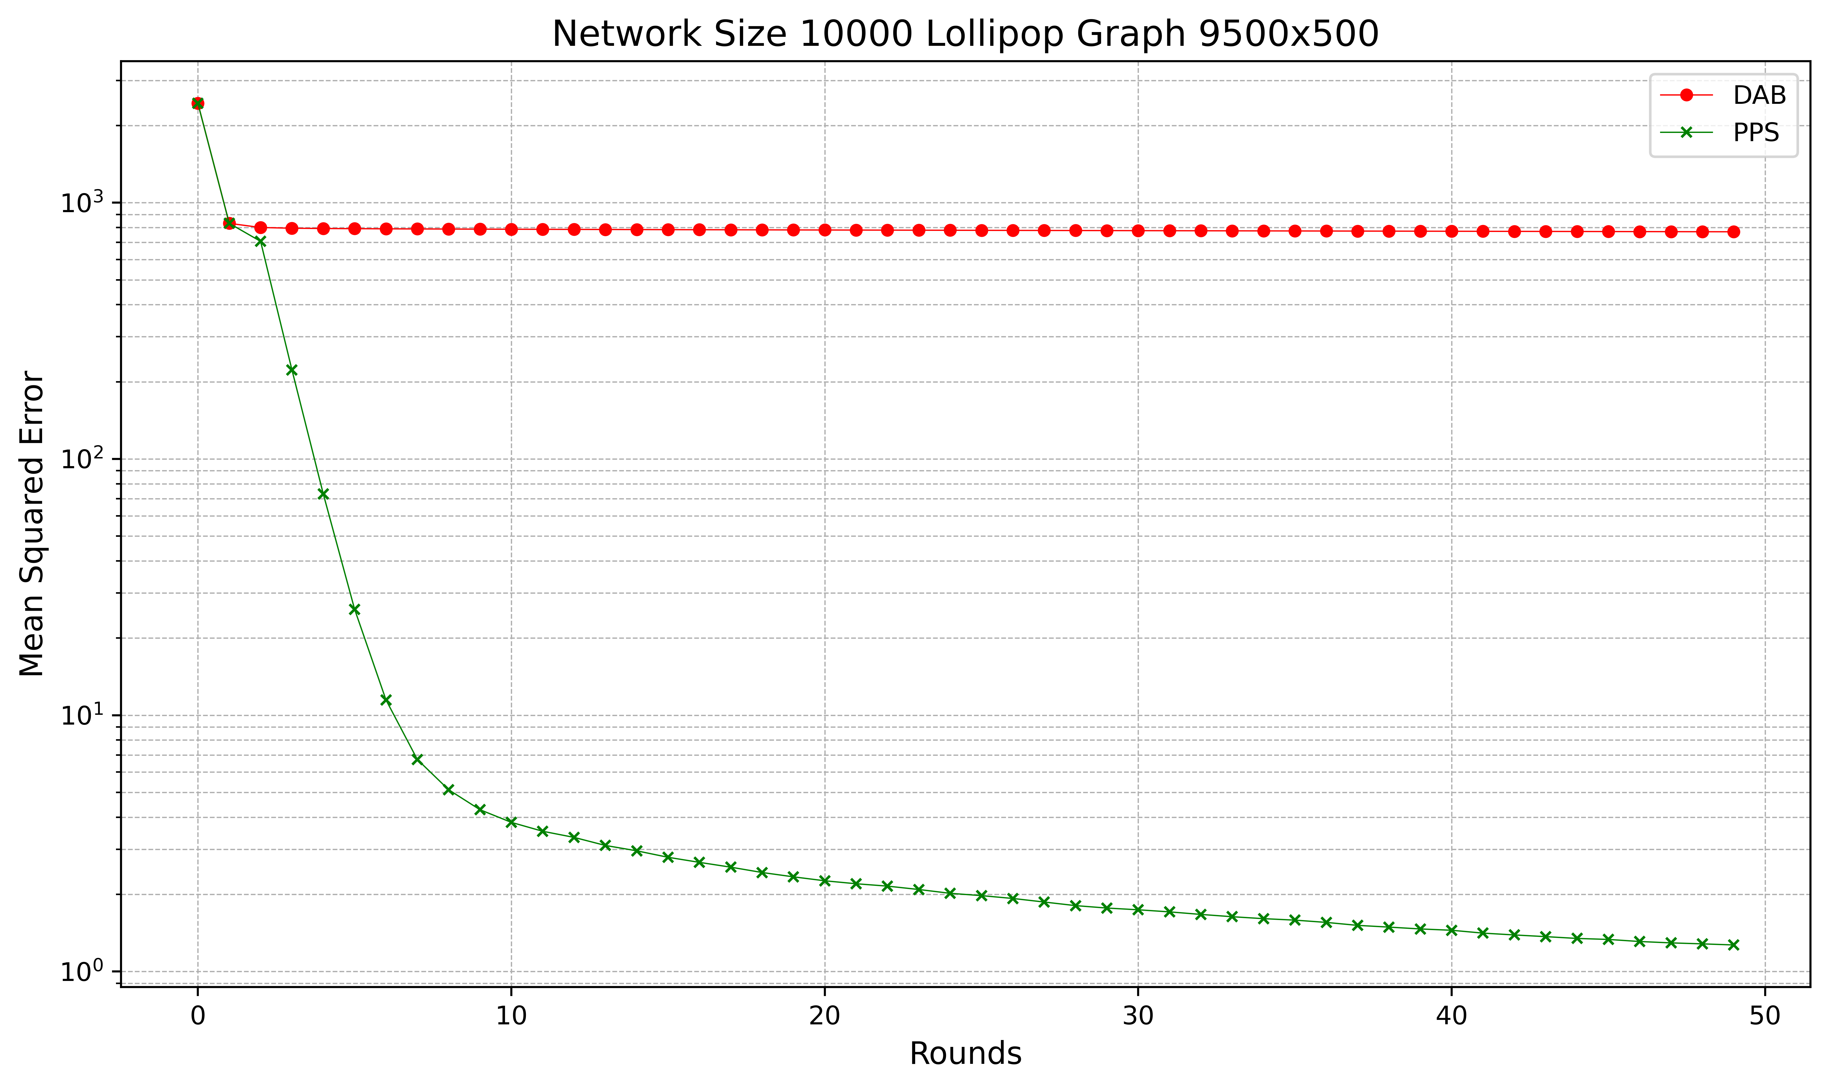

(9500, 500)-Lollipop Graph: Networksize 10.000

Slide 26
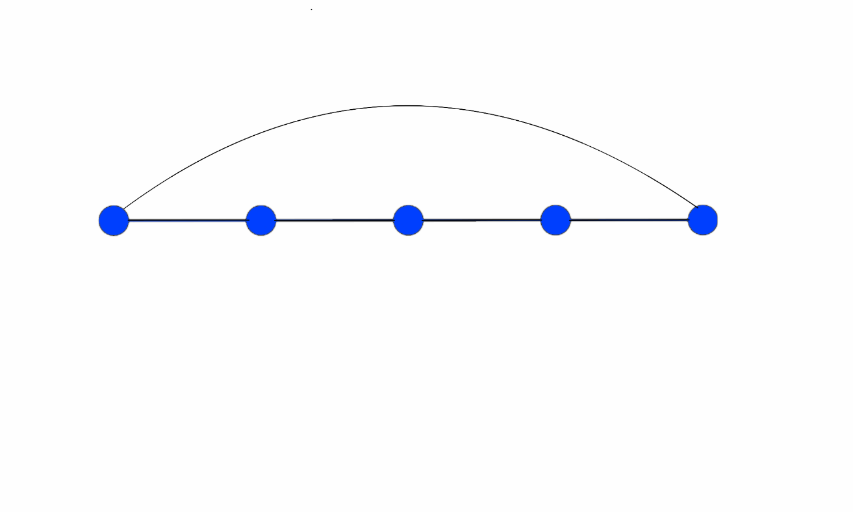
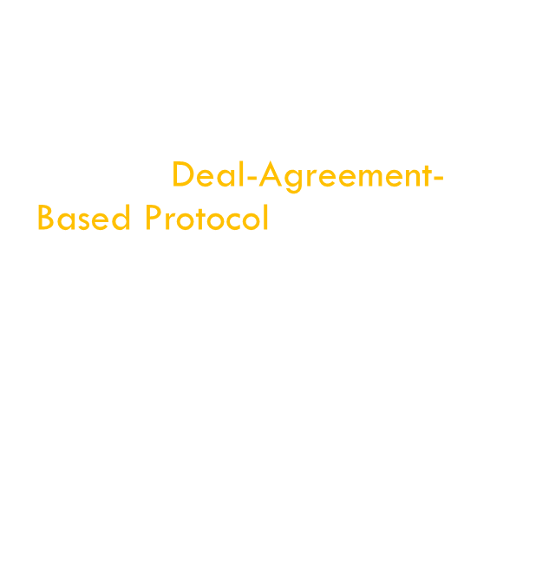
Closed Chain Graph
$n$ vertices
$n$ edges
winner: Deal-Agreement-Based Protocol

Slide 27
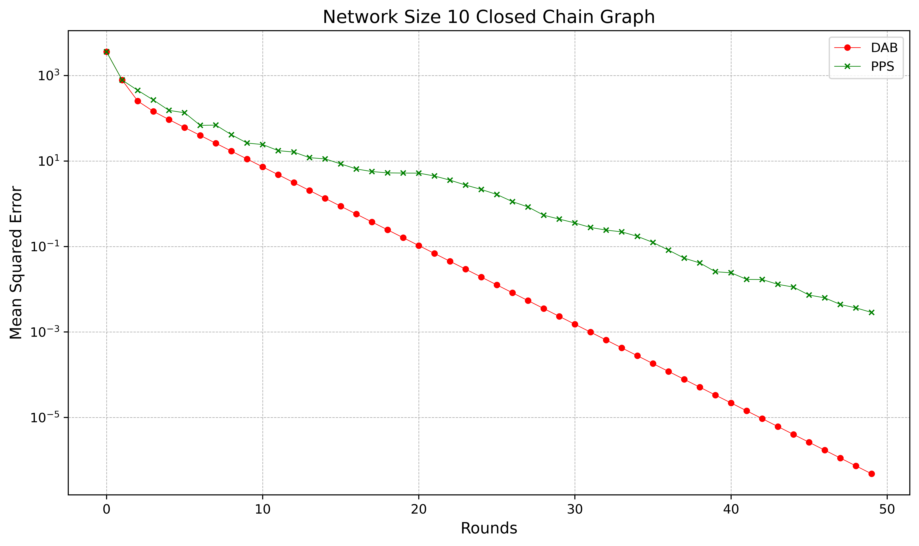
Closed Chain Graph: Networksize 10

Slide 28
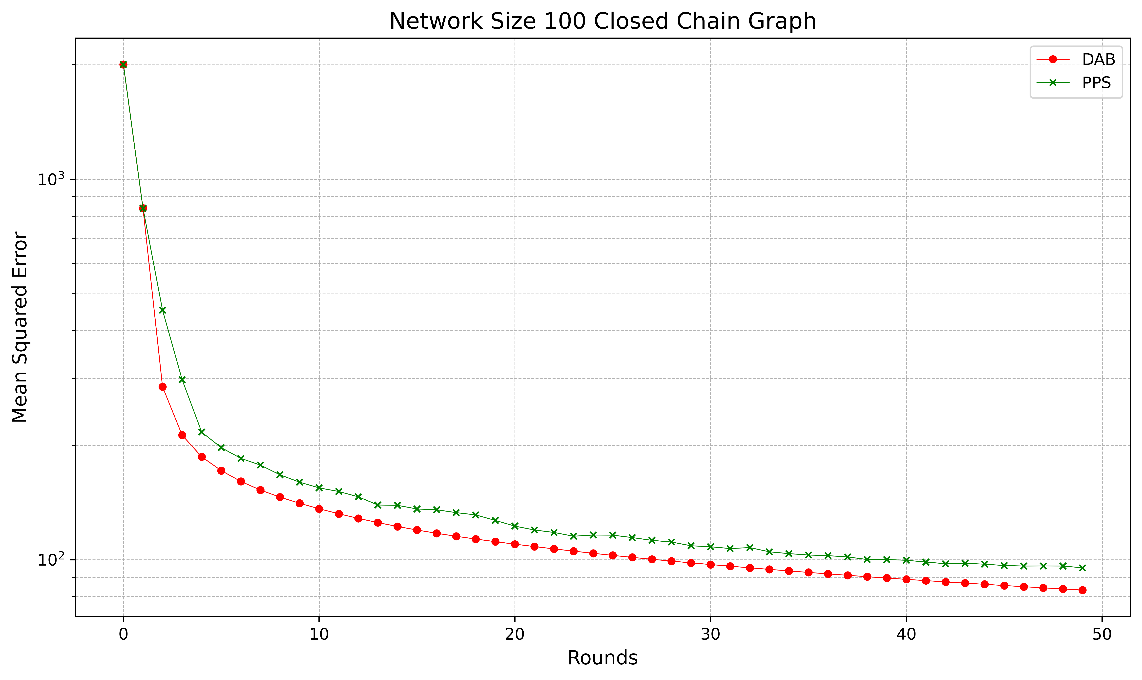
Closed Chain Graph: Networksize 100

Slide 29
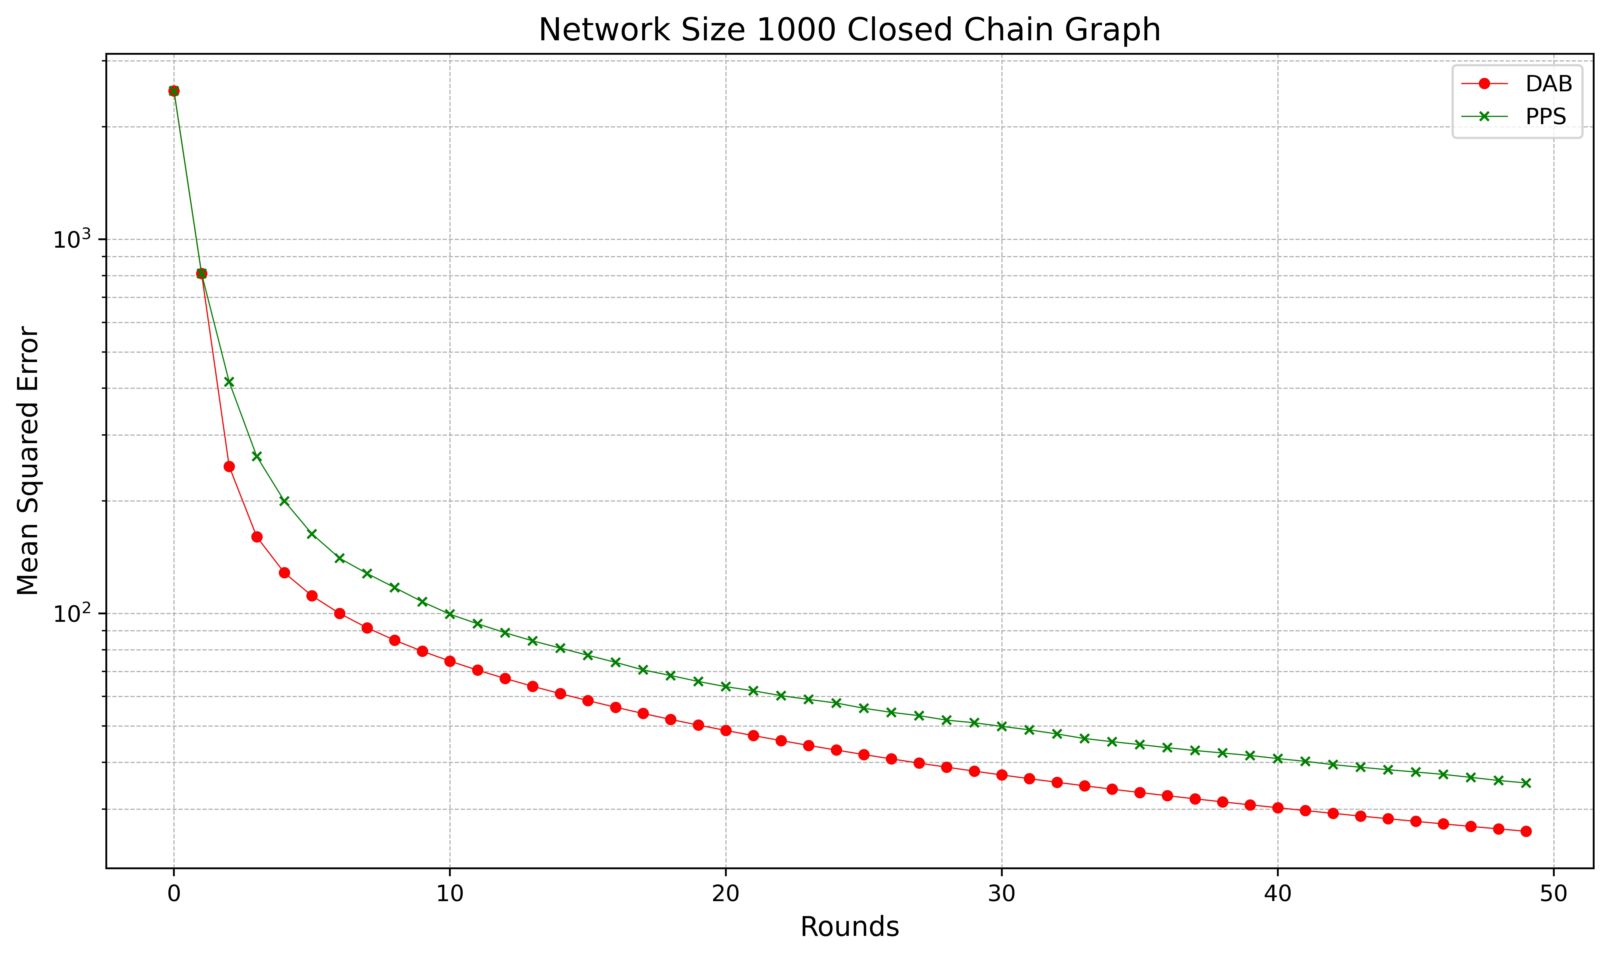
Closed Chain Graph: Networksize 1.000

Slide 30
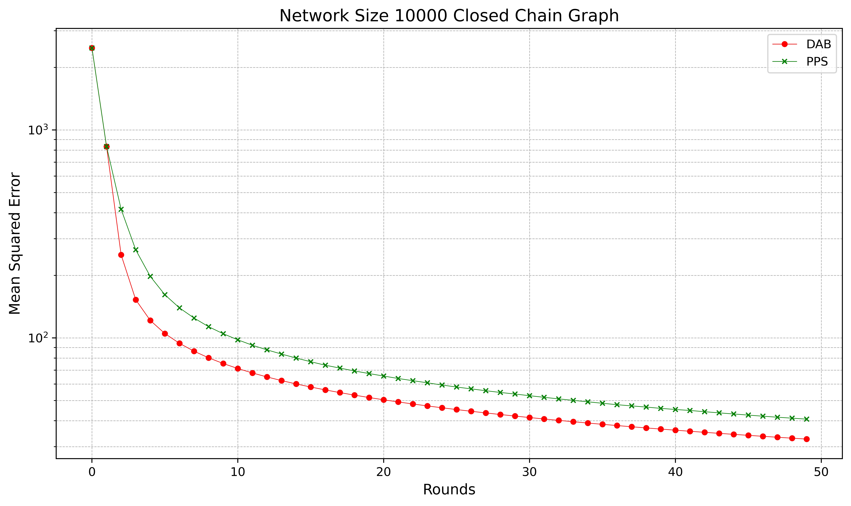
Closed Chain Graph: Networksize 10.000

Slide 31
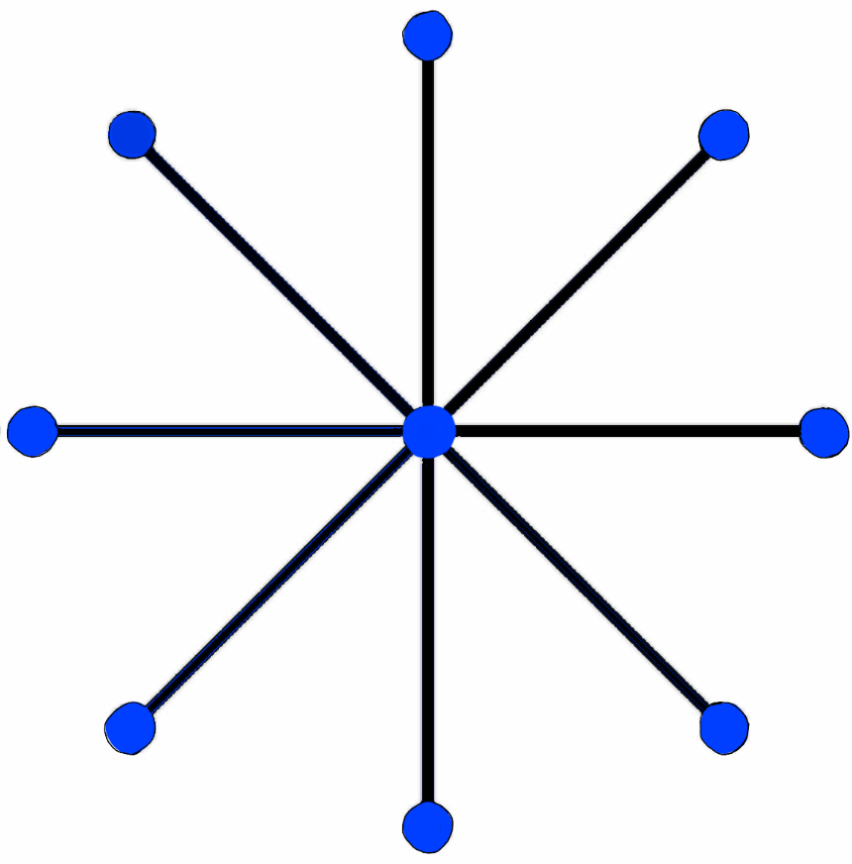
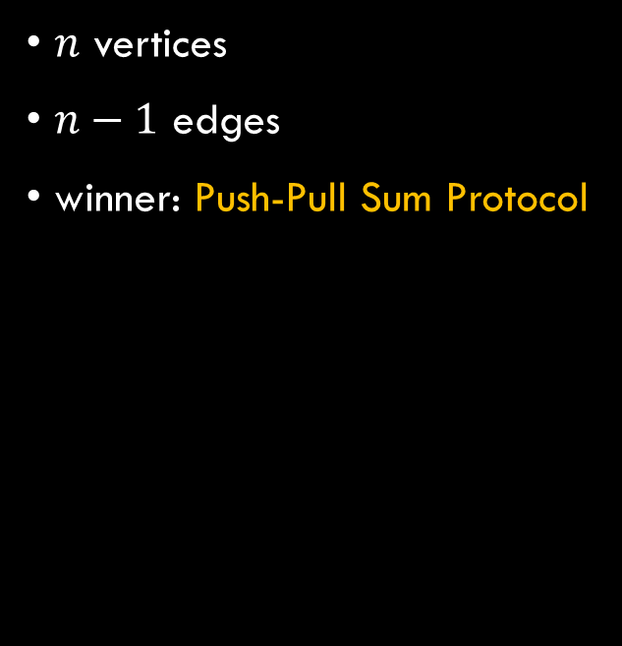
Star Graph
$n$ vertices
$n−1$ edges
winner: Push-Pull Sum Protocol

Slide 32
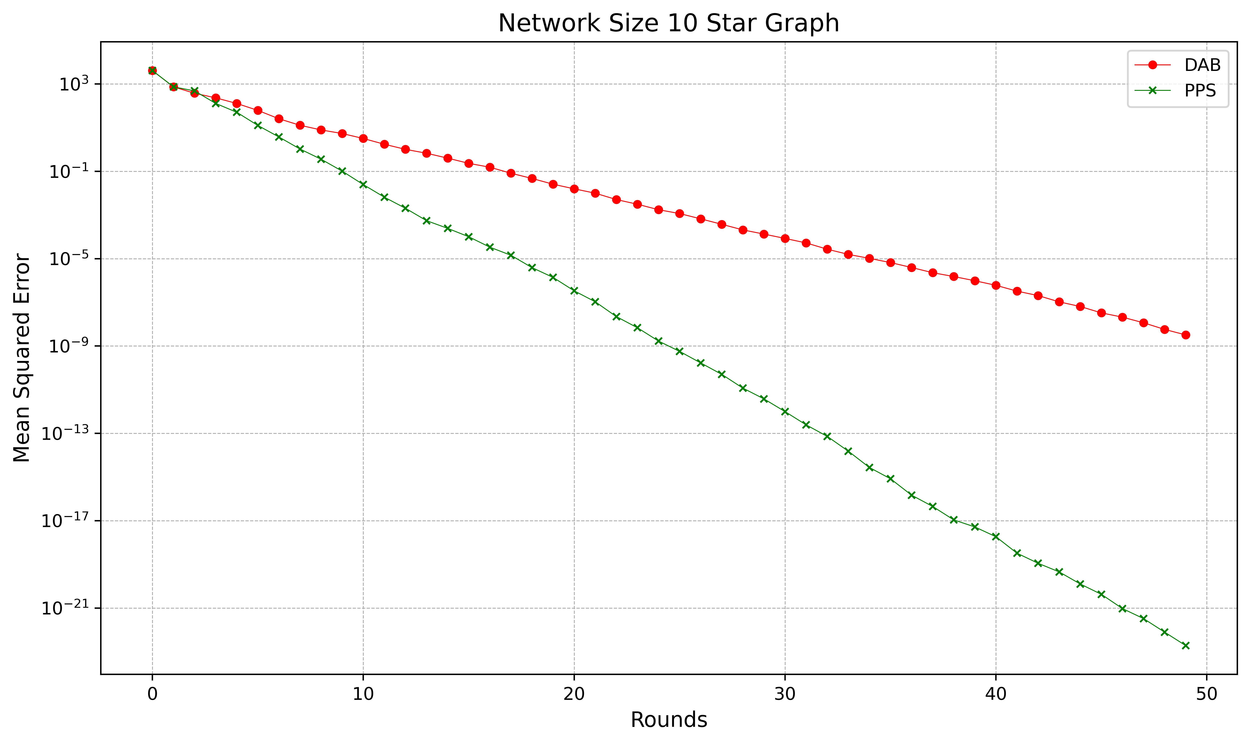
Star Graph: Networksize 10

Slide 33
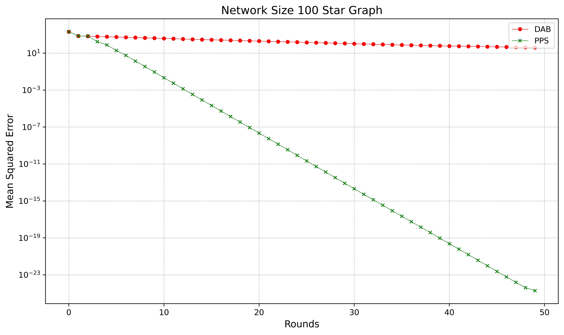
Star Graph: Networksize 100

Slide 34
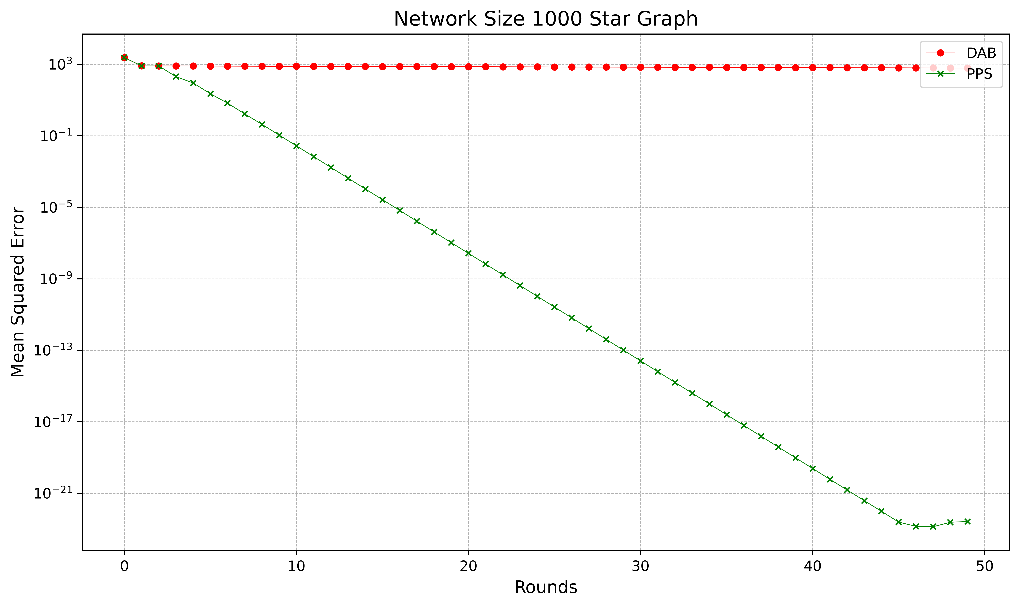
Star Graph: Networksize 1.000

Slide 35

Star Graph: Networksize 10.000

Slide 36
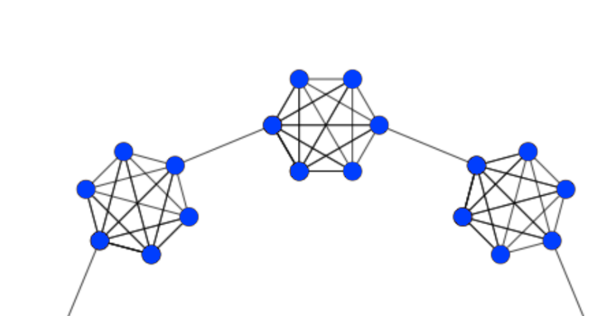
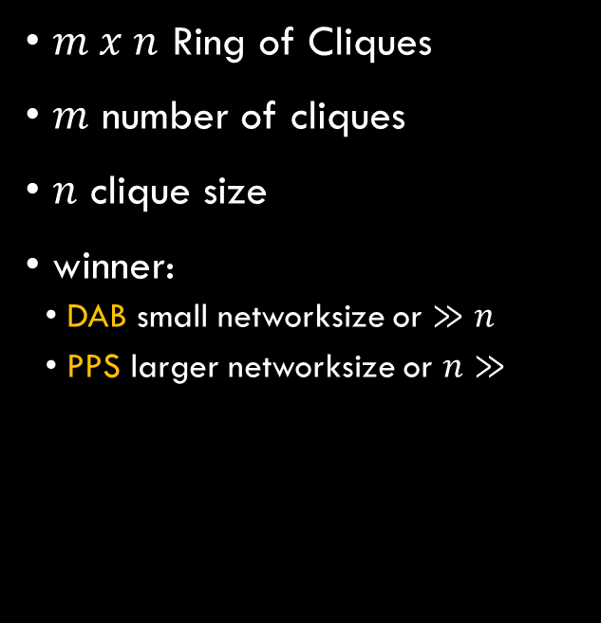
Ring of Cliques
$m x n$ Ring of Cliques
$m$ number of cliques
$n$ clique size
winner:
DAB small networksize or $≫n$
PPS larger networksize or $n≫$

Slide 37
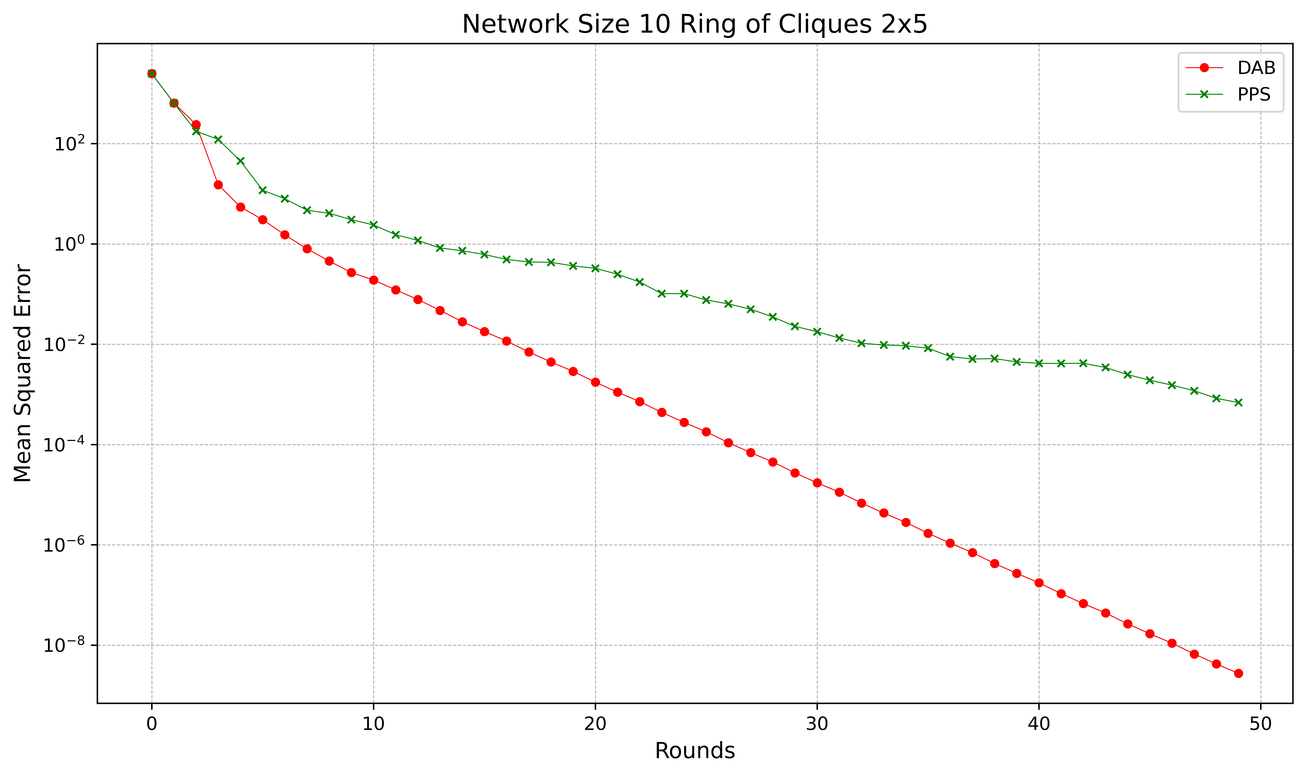
2x5 Ring of Cliques: Networksize 10

Slide 38
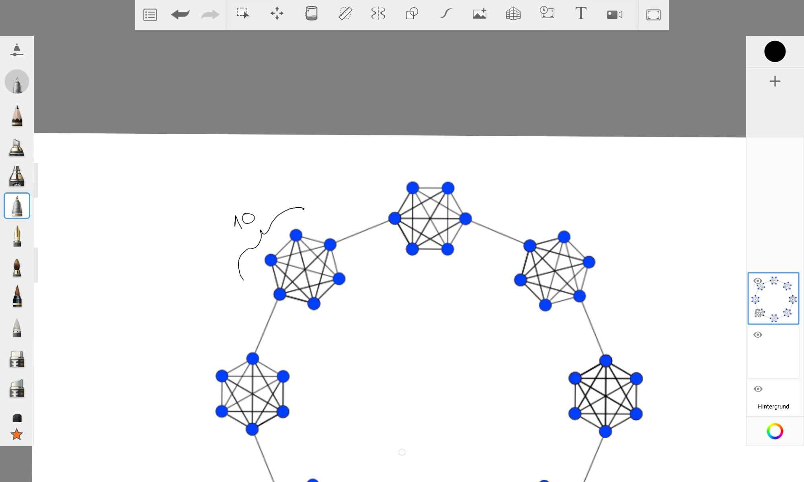
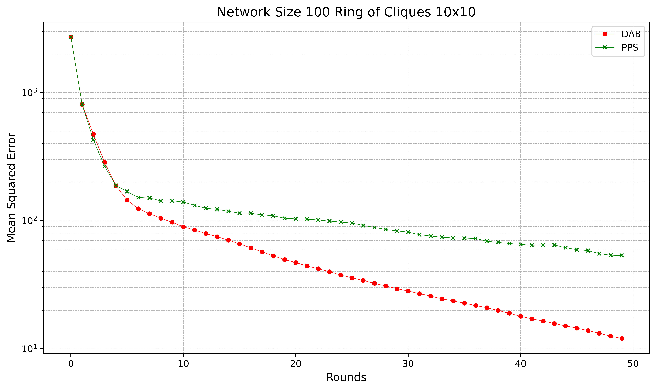
10x10 Ring of Cliques: Networksize 100

Slide 39
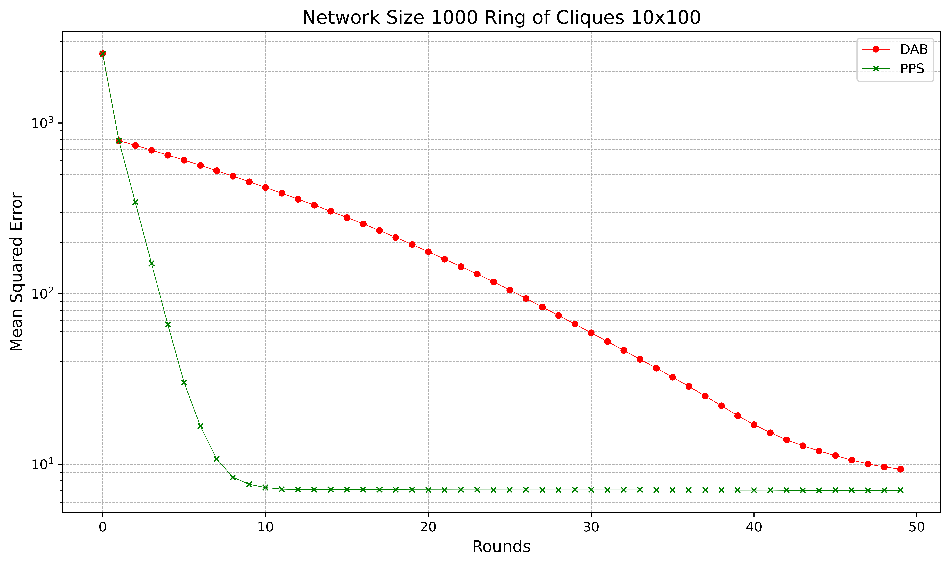

10x100 Ring of Cliques: Networksize 1.000

Slide 40
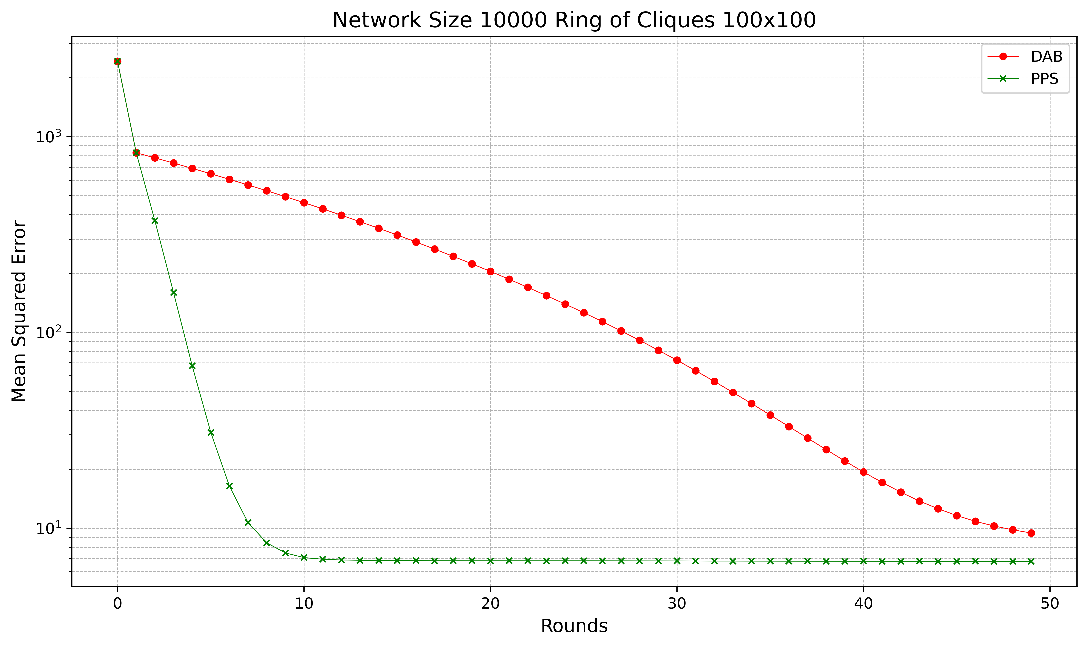
100x100 Ring of Cliques: Networksize 10.000

Slide 41
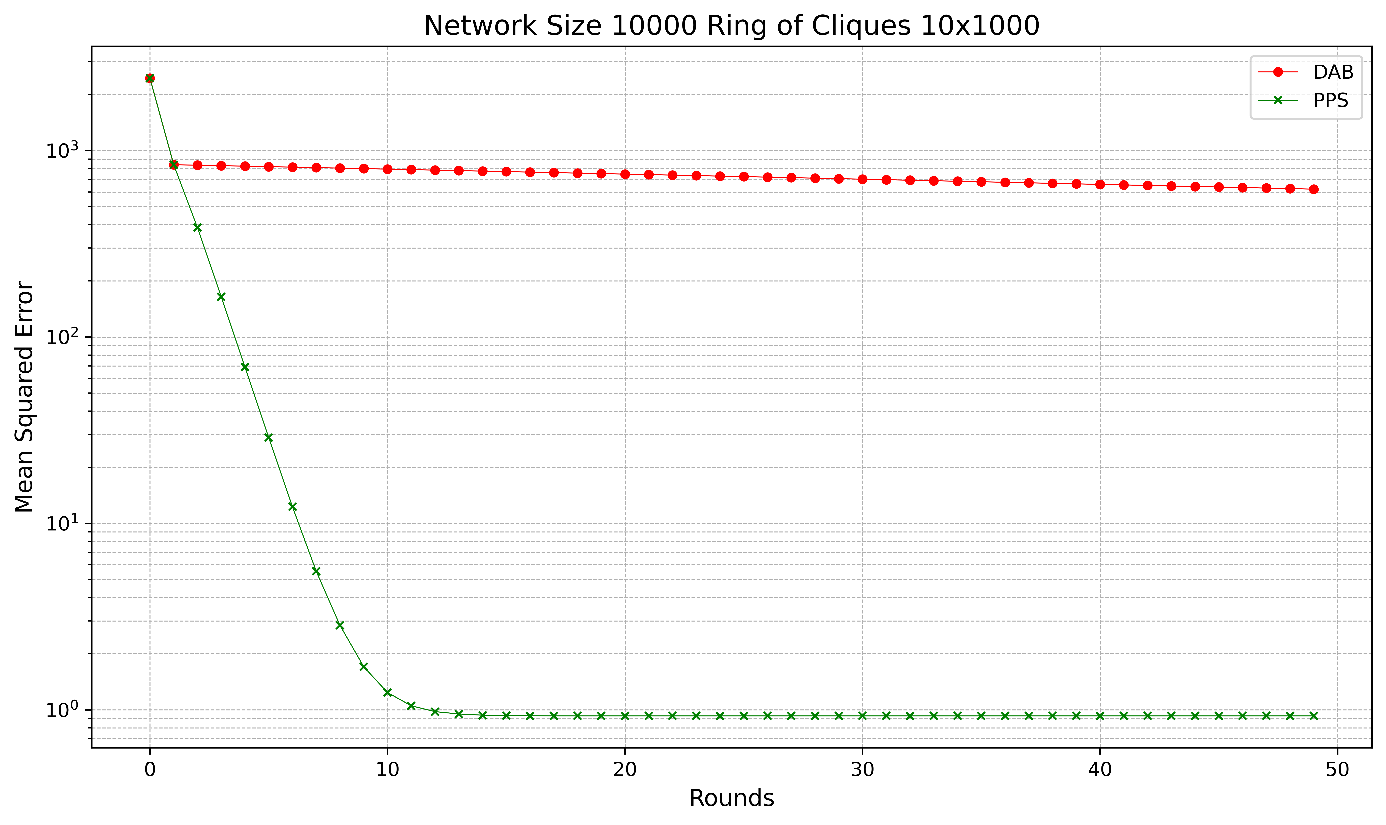
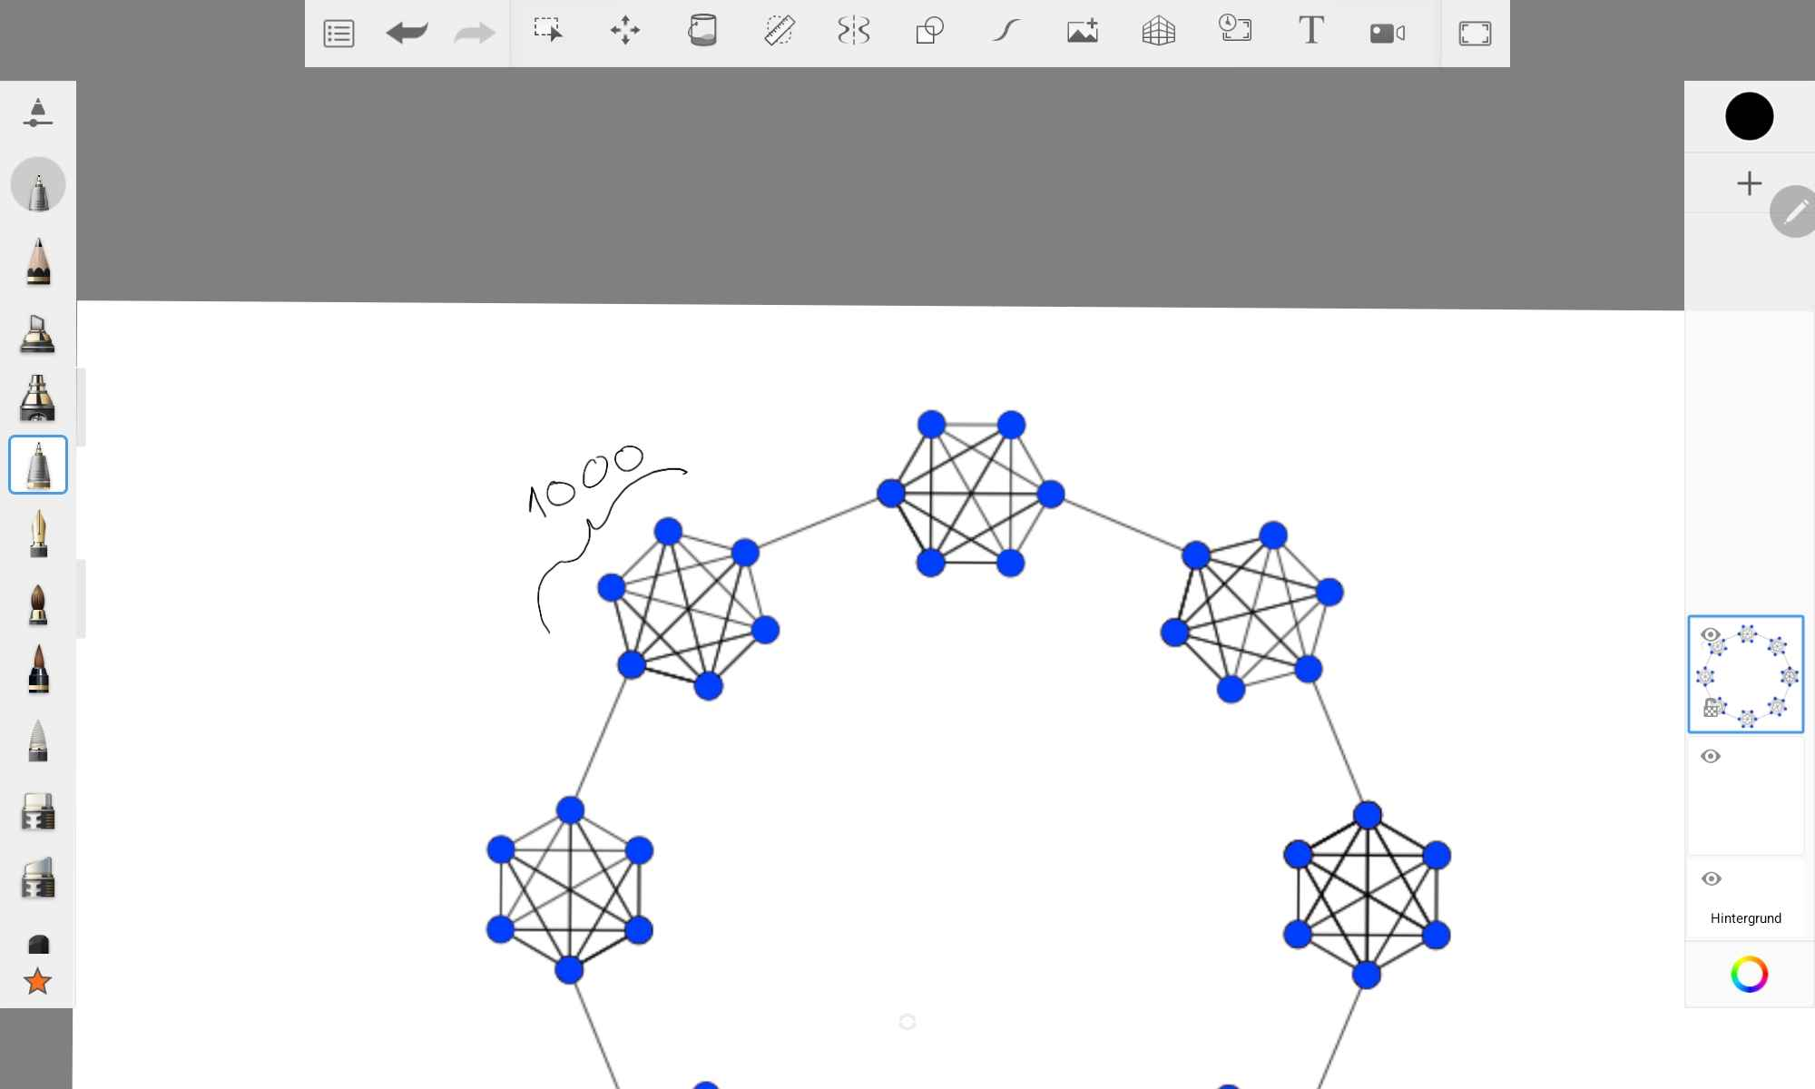
10x1000 Ring of Cliques: Networksize 10.000

Slide 42
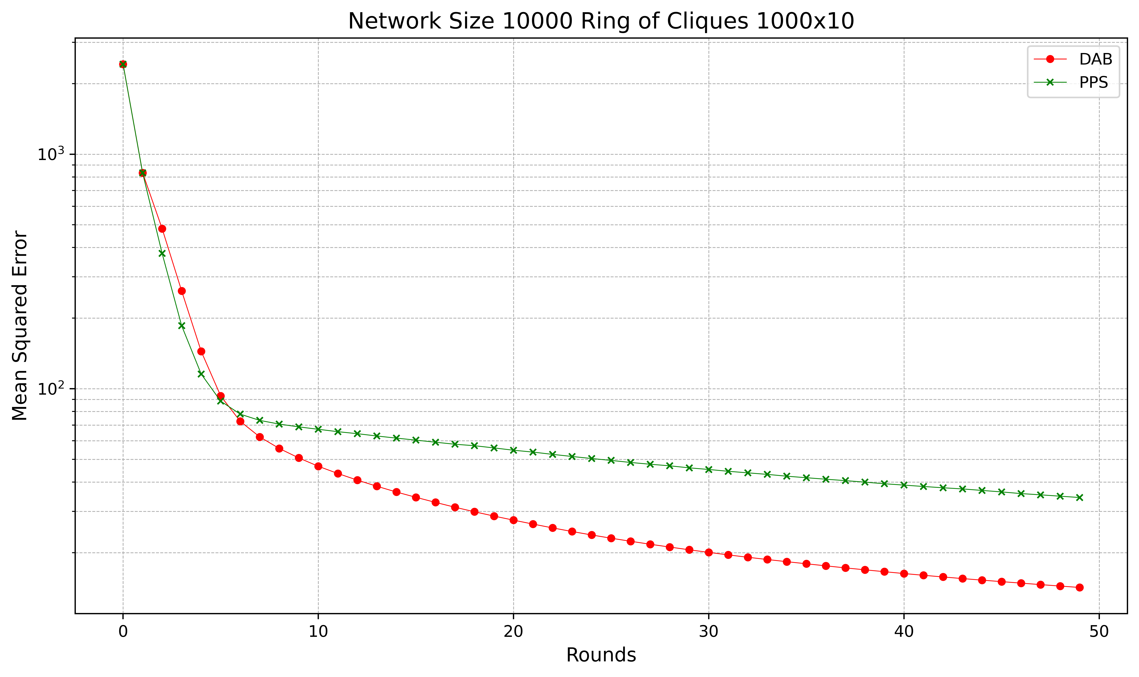
1000x10 Ring of Cliques: Networksize 10.000

Slide 43
Results summarized
Networksize | Complete | Grid |  |  | Lollipop |  |  | Closed Chain | Star | Ring of Cliques
10 | PPS | DAB |  |  | DAB > PPS (round 10+) |  |  | DAB | PPS | DAB
100 | PPS | DAB |  |  | DAB > PPS (round 30+) |  |  | DAB | PPS | DAB
1.000 | PPS | DAB |  |  | PPS |  |  | DAB | PPS | PPS
10.000 | PPS | 100x100 | 1.000x10 | 10x1.000 | 5.000, 5.000 | 500, 9.500 | 9.500, 500 | DAB | PPS | 100x100 | 10x1.000 | 1.000x10
 |  |  |  |  |  |  |  |  |  | PPS | PPS | DAB (rounds 7+)
 |  | DAB | DAB | DAB | PPS | PPS > DAB (rounds 7+) | PPS

Slide 44
Sources
Saptadi Nugroho, Alexander Weinmann, Christian Schindelhauer - "Adding Pull to Push Sum for Approximate Data Aggregation". In "Stabilization, Safety, and Security of Distributed Systems", Springer (2023), 75 – 89
Yefim Dinitz, Shlomi Dolev, Manish Kumar - "Local Deal-Agreement Algorithms for Load Balancing in Dynamic General Graphs". In "Theory of Computing Systems 67", Springer (2023) 348—382.
Anwitaman Datta - "Load Balancing in Peer-to-Peer Overlay Networks". In: LIU, L., ÖZSU, M.T. (eds), "Encyclopedia of Database Systems", Springer, Boston, MA.
Prof. Christian Schindelhauer - Graph Theory Course Slides - Chair of Computer Networks and Telematics (2021), University of Freiburg

Slide 45
Ressources
Figure [1] Nugroho, Saptadi, Alexander Weinmann, and Christian Schindelhauer. "Adding Pull to Push Sum for Approximate Data Aggregation." In "Stabilization, Safety, and Security of Distibuted Systems", page. 78. Springer, 2023. ISBN 978-3-031-44273-5. DOI: 10.1007/978-3-031-44274-2_7.
Figure [2] Dinitz, Yefim, Shlomi Dolev, and Manish Kumar. "Local Deal-Agreement Algorithms for Load Balancing in Dynamic General Graphs." In "Theory of Computing Systems 67, no. 2" (2023): page 355. DOI: 10.1007/s00224-022-10097-6.

